Slide 1






Fritzing for Circuits and PCBs (Hobbyist view of YET another “hobby within the hobby”)
Clinic Presented b y
Pat Fleming
NMRA 2024 surfliner convention
Email: PatFlemingHTC@Gmail.com
Presentation: https://github.com/patfleming/NMRA/raw/main/Fritzing_for_Circuits_and_PCBs.zip
Note: For Power point, use slide show (for links and slide animations)

Slide 2
Agenda
Why Create Custom PCBs
What is a PCB?
What is Fritzing?
From Design to Production and Test
Circuit Designs
Explore Fritzing
Flasher Circuit Example
Order a PCB
What’s Next for You?
Problem Solving
Backup

Slide 3
acknowledgements
Robert Heller
Developed Model Railroad System (Deepwoods Software)
Contributed to Layout Command Control (LLC)
Layout device schematics and LLC software
Inspiration and working basis of hardware and software for layout automation
AI using ChatGPT
Much needed companion for helping with efficiency of this ‘technical’ hobby within a ‘model railroad’ hobby
Presentation assistance by proof reading and editing speaker notes
Research assistance of software programming, electronics, schematics, etc...
Willing to help anyone…
Fritzing Credit
All breadboard, schematic and PCB images were created with Fritzing

Slide 4
terminology
TERM | COMMENT
PCB Layers | Fabricated layers that make up the PCB; silkscreen, copper, substrate
Ratsnest | Logical connection between parts (within a design)
Wire | Electrical connection between parts (within a design)
MIL | 1/1000 inch (used to measure width of a trace)
Arduino | Microcontroller – low cost, open source based
Trace | Electrical connection on PCB (board’s copper layer)
PTH Component | Plated Through Hole (electrical component with wire or legs
THT Component | Through Hole Technology (similar to PTH)
SMD Component | Surface Mounted Device (soldered on top of pad)
Via | PCB plated hole for connecting traces between top & bottom layer
Pad | Area of copper to solder an SMD
BOM | Bill of Materials – list of electrical components (parts)
DRC | Design Rule Check – Fritzing routine to valid PCB design against PCB fabricator requirements (mainly clearances)
TERM | COMMENT
FRITZING | Software for creating breadboard, schematic and PCB designs
PCB | Printed Circuit Board
Schematic (aka Circuit or Wiring Diagram) | Visual representation of an electrical circuit
Breadboard | Solderless construction base used for prototyping
JLCPCB | PCB fabricator (China)
Gerber File | Collection (zip) of PCB design files for fabricator
Palette | Window within a windows within Fritzing (frame)
Parts | Any item in Fritzing used in a design (PCB, breadboard, text, electrical components). Exception: wires
Bin | Container of Fritzing parts of Fritzing parts
Logo | Fritzing term for text and images added to the PCB silkscreen layer (top or bottom)
IC Package | Format of the Integrated Circuit (size, pins, etc..)
Circuit | Components that generate, use, and transmit electric current

Slide 5
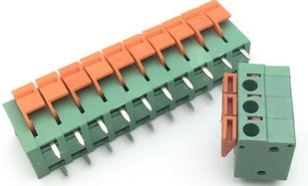
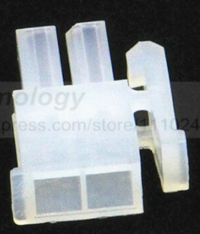
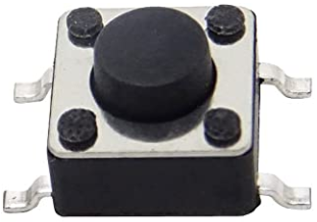
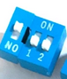
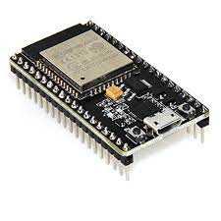
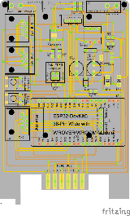
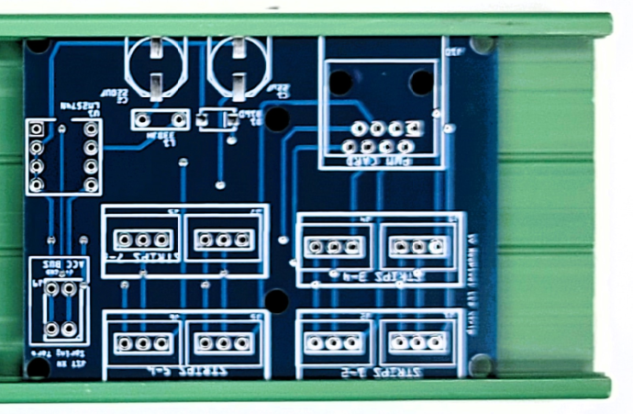
Why Create Custom PCBs
Circuit not commercially available
Reduced costs
Customization needed to align with layout requirements
Usability enhancements (DIP Switches, Tactile Buttons)
Add functionality (e.g. Integration with Arduino)
Simplify layout wiring
Custom size and shape
Make mountable
Notes:
Let’s look quickly why you may want to create your own PCB
The circuit design we require is not readily available in the commercial market. For instance, you may come across a circuit example in a model railroad blog or publication that you would like to utilize
Adapting a circuit to your layout requirements. For example, changing terminal connectors to spring terminals or Molex connections
Adding controls via Tactile buttons and DIP switches
Adding functionality by combining an Arduino and circuit on the same PCB
PCB modifications to accommodate mounting or space requirements. For examples, adding holes for screws/standoffs, resizing for a PCB housing.

Slide 6
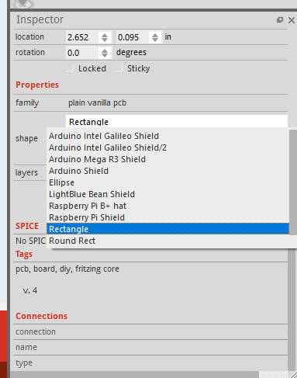
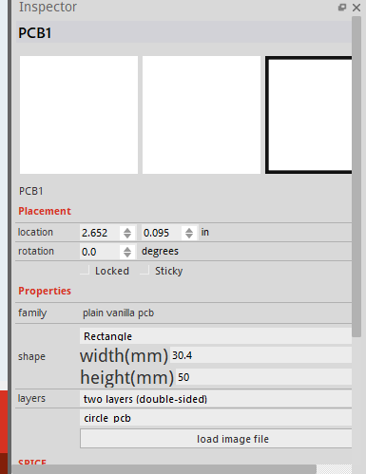
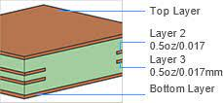
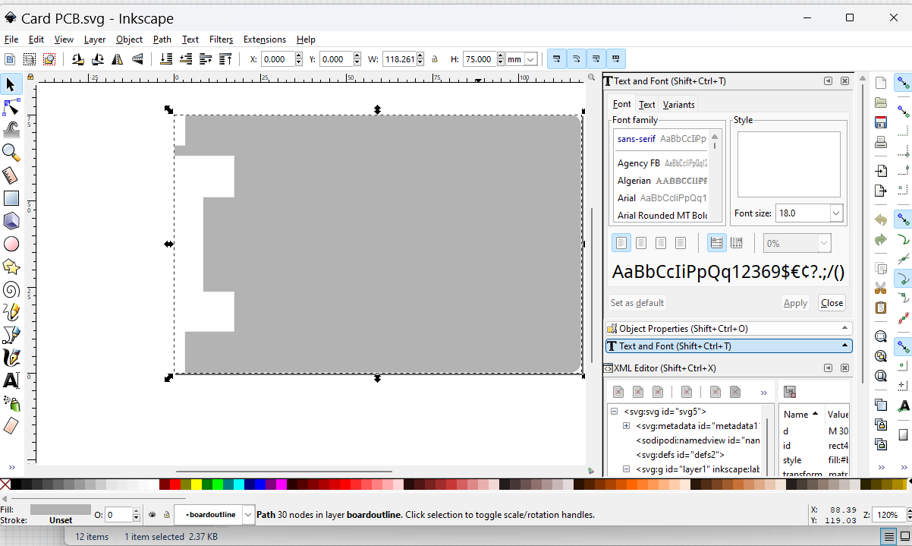
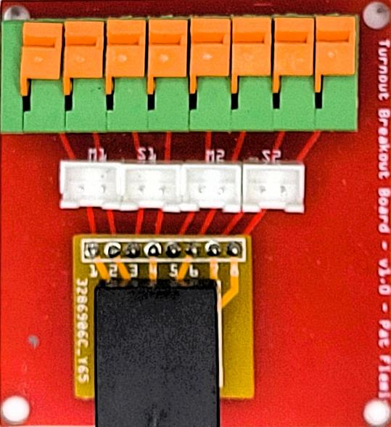
WHAT is a PCB
Printed Circuit Board (PCB)
Provides electrical conductivity between components via copper ‘traces’
Can have 1, 2, 4 or more layers of copper
Fritzing designs 1 and 2 layer PCBs (2 is most common)
JLCPCB fabricates 1 to 20 layers for rigid PCBs
Can be designed in various sizes and thicknesses
MAX Size: 400mm x 500mm (JLCPCB)
MIN Size: 5mm x 5mm (JLCPCB)
Thickness: 0.4mm – 2.5mm with 1.6mm default (JLCPCB)
Can be designed in many shapes
Fritzing supplied shapes (rectangle is the default)
Click in the shape input field, select from drop down list
Create custom shapes using SVG editor (e.g. Inkscape)
Load custom shape from Inspector Palette Window:
click on “load image file” button, select SVG file
Can be fabricated in various colors and materials
Materials: FR-4 ($, most common), Aluminum ($$), Flex ($$) , Teflon ($$)
Notes:
PCB stands for printed circuit board.
A PCB provides electrical connectivity between electrical components installed on the PCB.
PCB are created in layers, multiple layers of copper for connectivity. Fritzing supports a top and optimal bottom layer of copper. Other PCB editors might support more layers. Fabricators can support production of boards with many layers of copper.
The range of a PCB size is determined by the editor and the fabricator. Fritzing and JLCPCB support PCB sizes from 5mm to 500mm. JLCBPCB supports a PCB thickness from 0.4mm to 2.5mm. 1.6 is the default and most common thickness.
Most PCBs are rectangular, but custom shapes are possible. The PCB outline has to be created using an SVG editor such as Inkscape and loaded into the PCB editor. Fritzing can load a custom shape by selecting the PCB image in the main window, then in the Inspector Palette Window, select the ‘load image file’ button to load the SVG file.
PCB Fabricators might support various materials for the PCB. JLCPCB supports the most common substrate material called FR-4. For additional cost, the substrate can be aluminum, flex material, or Teflon.

Slide 7
What is Fritzing
PCB Design Tool and more…
Open Source Hardware Initiative
Cost: $9.29 for v1.0.0 (as of June 19, 2023)
For years the beta version was free, until v1.0.0 was released
Make sure your Windows scale is set to 100% or 200% (Settings -> Systems -> Display -> Scale)
Runs on Windows, Mac, and Linux (download)
Developed for hobbyists and amateurs to create electronic hardware
Useful in creation of PCBs for use with Arduino based projects
Large user community
Large number of parts (components)
Fritzing GitHub Repositories (docs, parts, etc...)
Wikipedia

Slide 8
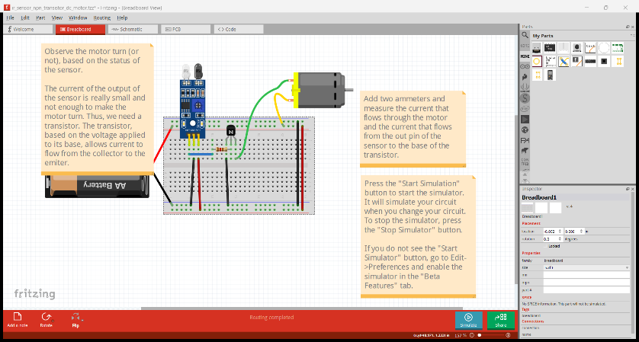
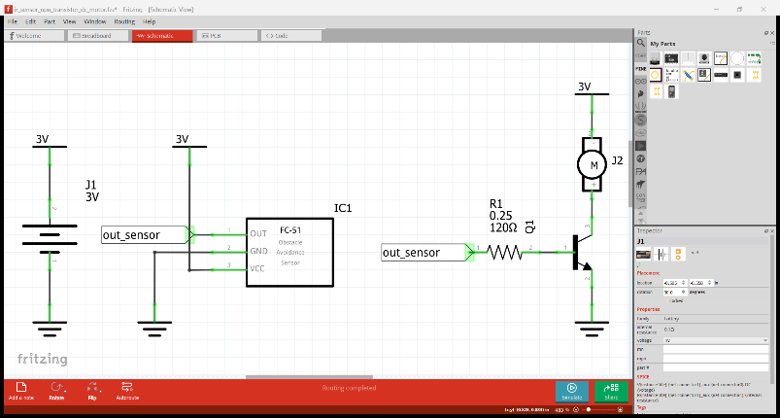
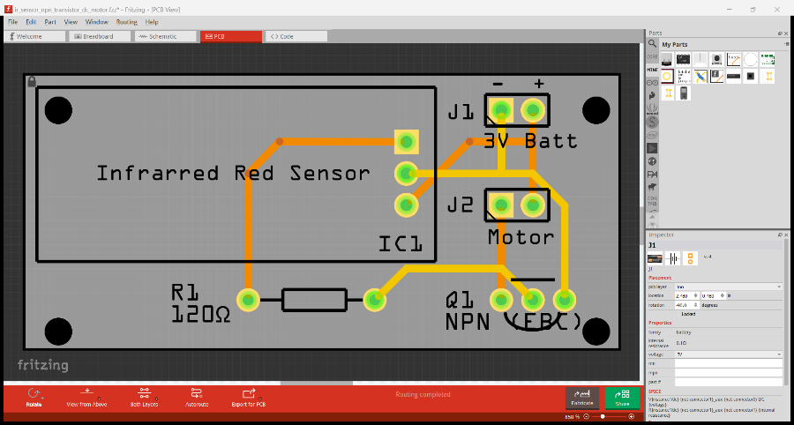
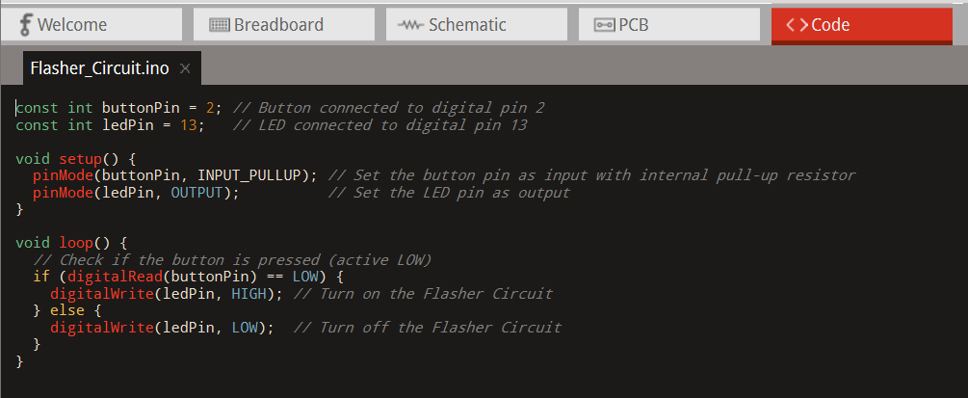
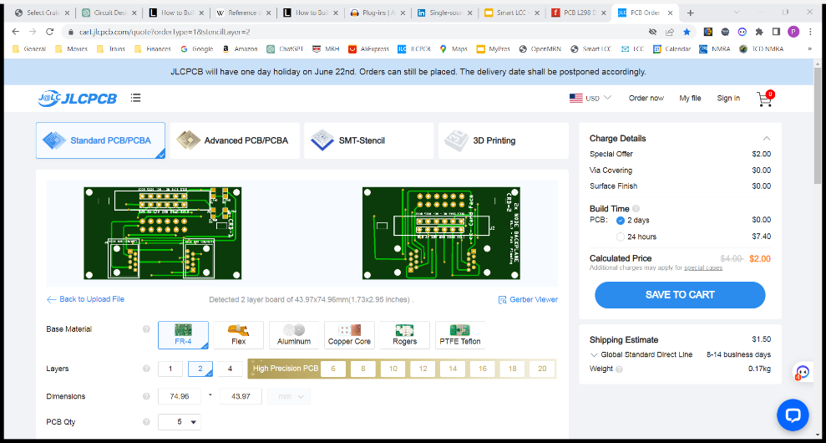
From Design to Production
Fritzing provides integrated tools for an entire PCB development process as follows:
Breadboard View
Experimentation of circuit’s design on a breadboard
Circuit Simulation (beta) – simulate breadboard and schematic
Supported parts – see SIM bin in Parts palette window
Schematic View
Capture an existing circuit design
Modify existing circuit designs
Create a new circuit designs
Logisim – design / simulate circuits (free)
PCB View
Placement of components on PCB
Layout traces between components
Design Rules Check (DRC) tool
Code View
Design software for the Arduino
Compile/Upload firmware to Arduino
Production
Creation of files for use for production
Notes:
Let’s quickly touch on the overall steps for producing PCBs. Each of these steps can be optionally addressed within Fritzing.
To start, you’ll need a design of what you want for a circuit(s) on the PCB. Typically the design is a ‘schematic’ of the circuit(s) for the PCB. This could be an existing schematic you’ve found or one that you created. For a simple design, you might just draw it on paper or use a schematic design tool for retention or because of complexity. Fritzing has an integrated Schematic editor that we’ll look at in a bit.
With a design in mind, you my want to first test it out on a breadboard. This is often done when first learning electronics or testing with a new component. Testing on a breadboard is also done when integrating with an Arduino and to test the corresponding software. Fritzing has an integrated Breadboard feature for helping with capturing and documenting the component wiring on the breadboard, along with optional notes.
Before creating a printed circuit board (PCB), it is necessary to design it using specialized design tools supported by the PCB fabrication process. One such tool is Fritzing, and there are other options like KiCad, Eagle, and EasyEDA. Fritzing is considered one of the easiest tools to learn and allows for both simple and complex PCB designs.
Typically, PCB fabrication involves uploading the output of the PCB design tool to a PCB fabricator's website, such as jlcpcb.com or pcbway.com . Alternatively, there are other fabrication options available, such as DIY via etching. Additionally, PCBs can be cut using a CNC router or laser printer.

Slide 9
Circuit Designs Which DESIGN – Breadboard, schematic, or Code design
PCB design is required for PCB fabrication.
Schematic and breadboard designs are optional
Schematic design is useful when:
There is a need to document the design's circuit as a diagram
Sharing the design with others for validation or open source
Breadboard design is useful when:
Experimenting with the circuit before fabrication, e.g., trying different component values or types
Validating modifications to existing circuits
Utilizing it as a learning experience for yourself or others
Code design within Fritzing is useful when:
Shared as an Arduino code example for the circuit
Notes:
PCB design is necessary when you want to create the actual circuit board.
Schematic and breadboard designs, on the other hand, are not mandatory but can be beneficial in specific situations.
Creating a schematic is advantageous when you need to represent the circuit's design in a visual diagram. It is particularly useful for sharing the design with others for validation or open-source purposes.
On the other hand, breadboard design serves a purpose when you need to experiment with the circuit before actual fabrication. This includes trying out different component values or types. It also comes in handy for validating modifications to existing circuits and can serve as a valuable learning experience for yourself or others.

Slide 10
Circuit Designs order of Design creation for PCB fabrication
Fritzing doesn’t require all circuit design methods to be implemented
Start with what you have, if anything
Create only the designs that are needed
You can always revisit Fritzing and complete other designs.
For example, after starting with a PCB design
Create a schematic design of the circuit to share with others
Create a breadboard design to test a failing PCB design
Scenario | Flow of Design Creation | Comments
Only a PCB is needed from a working schematic | PCB | Add schematic later if needed for sharing design
Modifying existing schematic | Schematic -> Breadboard -> PCB | Modify existing schematic, validate with breadboard, then create PCB
Need to document circuit | Schematic -> PCB | Create schematic first, then PCB.
Creating new design, without sharing | Breadboard -> PCB | Create breadboard design with testing first, then PCB
Simple circuit design | PCB | No IC, just connections to terminals and basic components (resistors, capacitors). E.g. LED connection PCB with current limiting resistors.

Slide 11
Explore Fritzing

Slide 12
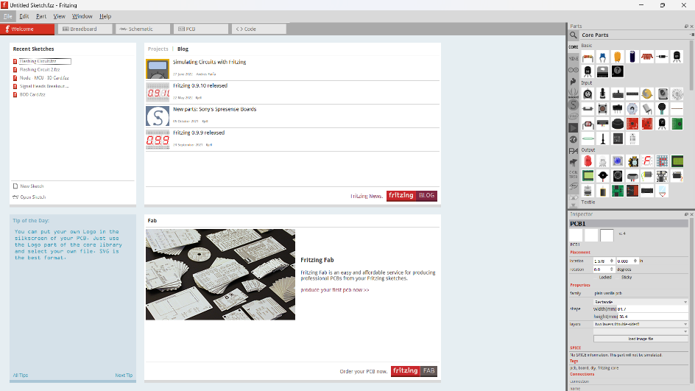
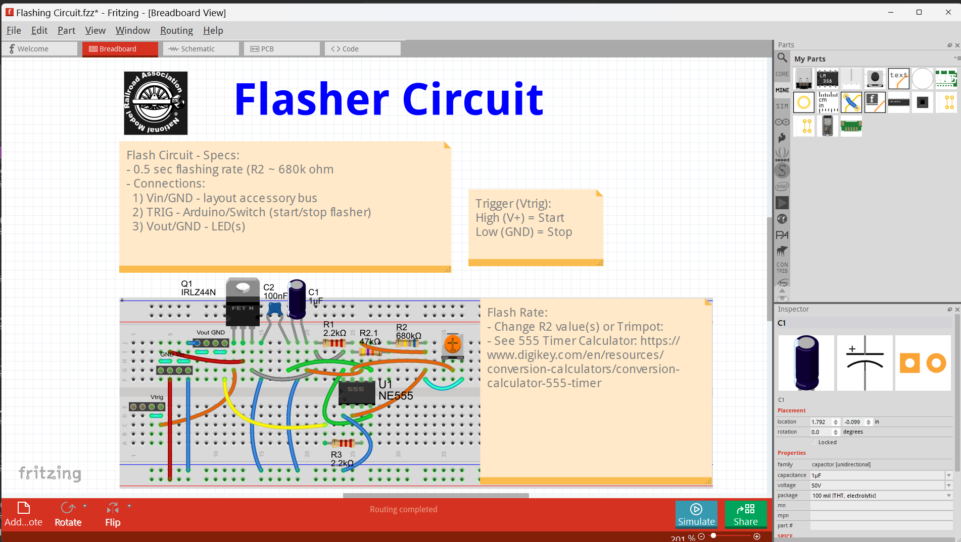
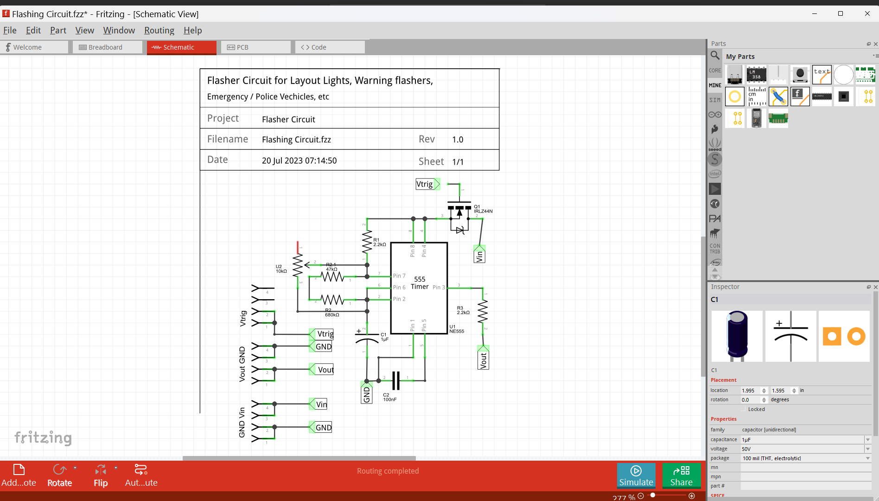
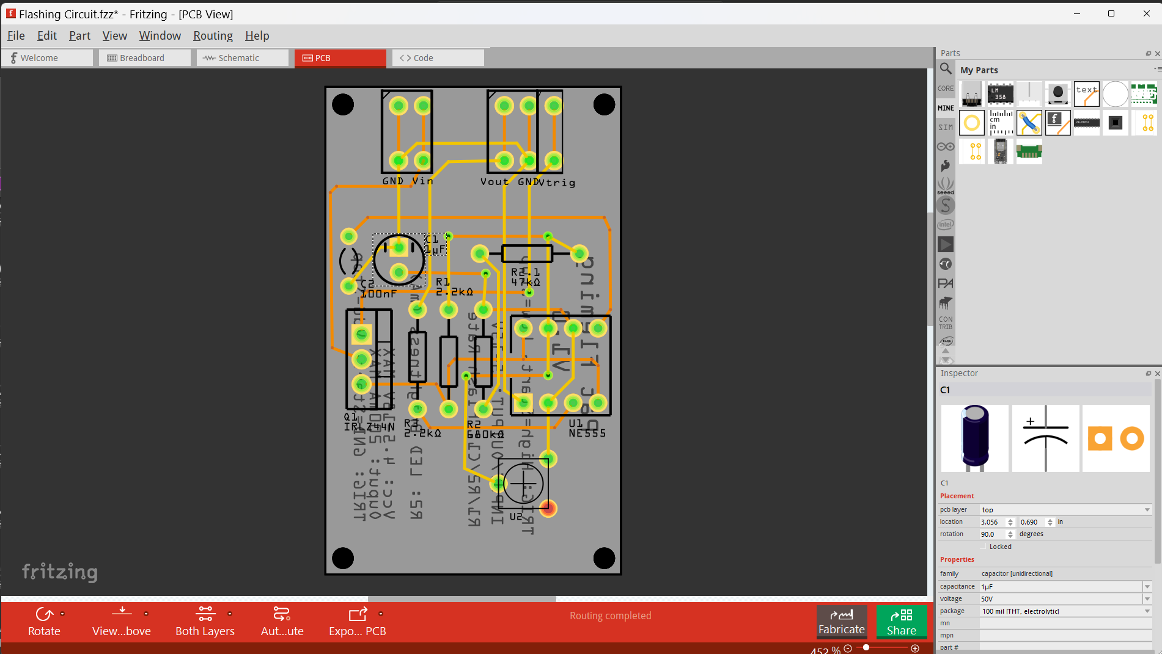
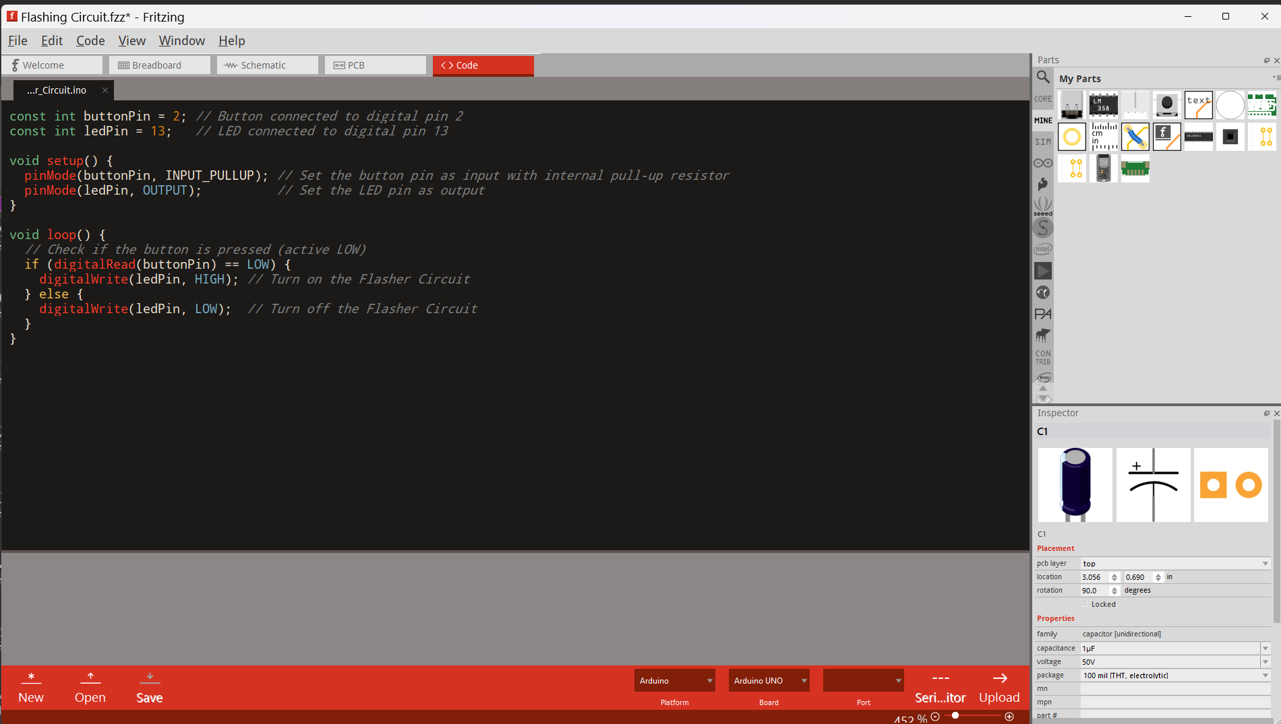
Fritzing Tabs and palettes
Window Palette | Use | Comment
Main | Circuit design workspace | Edit design
Parts | Select parts | Parts grouped in bins, search option
Inspector | Review and change part information | Select part variants, change values
Tab | Use (control main palette window) | Comment
Welcome | Access recent sketches | Recent sketches
Breadboard | Create breadboard design | Optional, experiment / test design
Schematic | Create Schematic diagram | Optional, document design
PCB | Create PCB design | Required for PCB fabrication
Code | Develop code for Arduino boards | Develop sketch (code) in Arduino IDE, share here
Notes:
When you open the Fritzing application, the home screen is presented and a new untitled sketch is started. Fritzing projects are called sketches and saved as *.fzz files.
There are options on the screen to selected recent sketches and tabs at the top that provide access to the four different circuit views: Breadboard, Schematic, PCB, and Code.
Within the Breadboard, Schematic, and PCB views of Fritzing, there are three windows. The main window is where the circuit's schematic is drawn, while the Parts palette window is positioned in the upper right corner. Additionally, the Inspector palette window is located in the lower right corner. Both palettes can be relocated by dragging them using their header.
In order to facilitate the positioning of components within the main window, a grid is commonly employed. To configure the grid settings, you can follow these steps: at the top menu, select View, then choose Align to Grid and Show Grid and Grid Size. It is recommended to set the grid size to 0.1 inch, which is the default size for most parts. Later on, during the PCB creation process, the grid size can be adjusted for more precise spacing of the traces, allowing for greater accuracy in the layout.
The upper right palette window in Fritzing contains the parts for various components. These parts are organized into 'bins' that are displayed on the left side of the parts palette window. To navigate through the list of parts bins, you can utilize the up and down arrows located at the bottom of the list, allowing you to scroll through the available options.
The second item in the parts bin list, right below the top, is the MINE bin. This bin serves as a designated space where you can store a custom list of parts for quick and convenient access. To add a part to the MINE bin, you can begin by selecting a part from either the parts displayed in the Parts palette window or from your existing circuit. Next, right-click on the selected part and choose 'Add to Bin...' located towards the bottom of the list. This action will add the part to the MINE bin for future use.
If you need to search for specific parts within the Parts palette window, you can do so by scrolling to the very top of the bin list. There, you will find a Magnifying Glass icon. By clicking on this icon, a search window will open, allowing you to easily locate and find the desired parts.
The Inspector palette window, located in the lower right area of the display, provides access to view and modify information about the parts in your circuit. When designing a part, the designer often includes multiple 'variants' of the part, which can be selected in the 'package' field, such as THT (through-hole) and SMD.

Slide 13
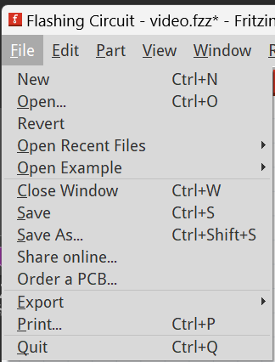
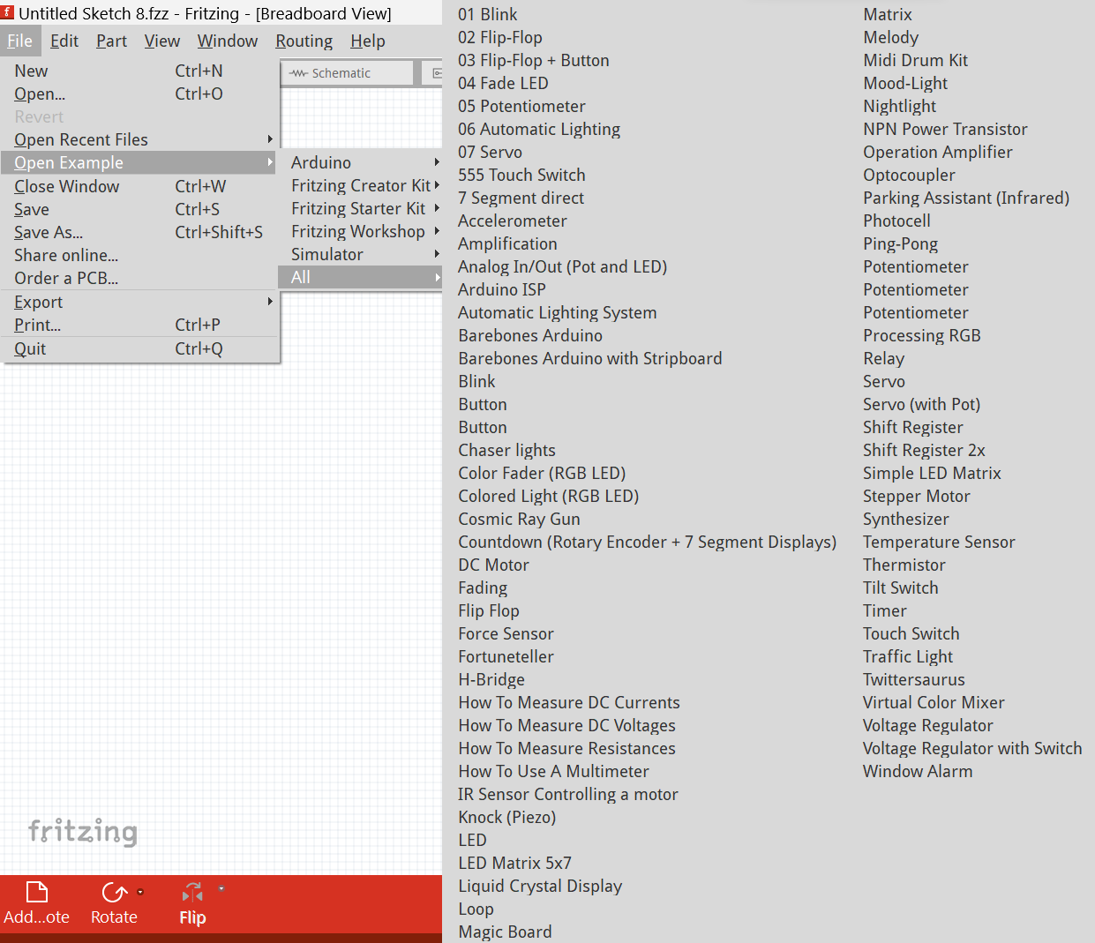
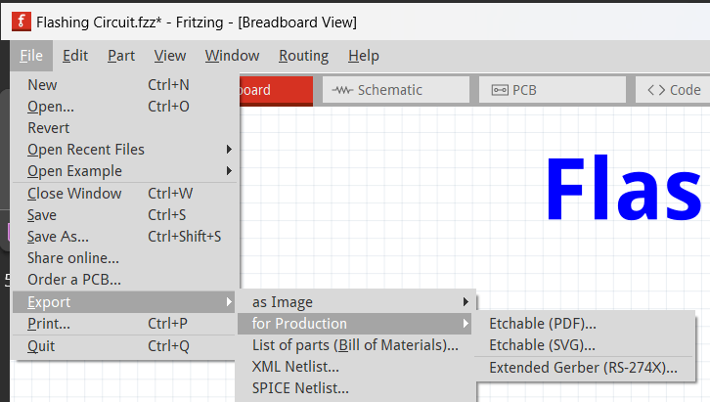
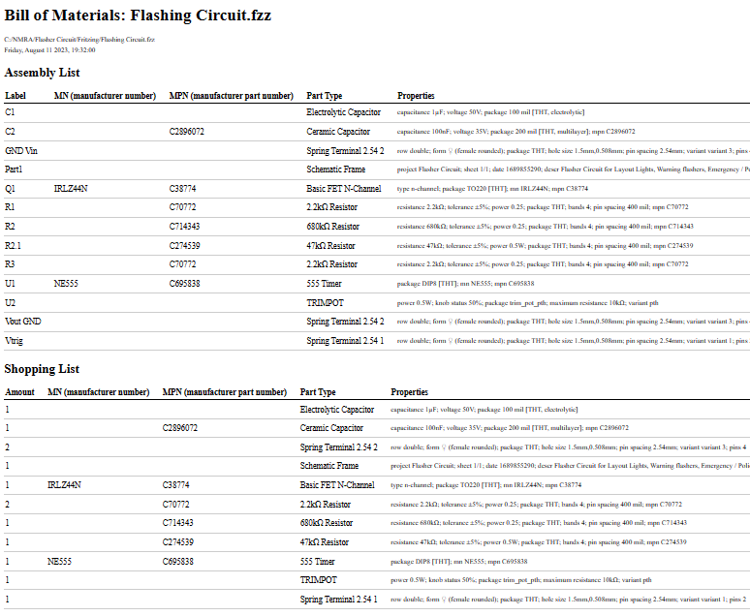
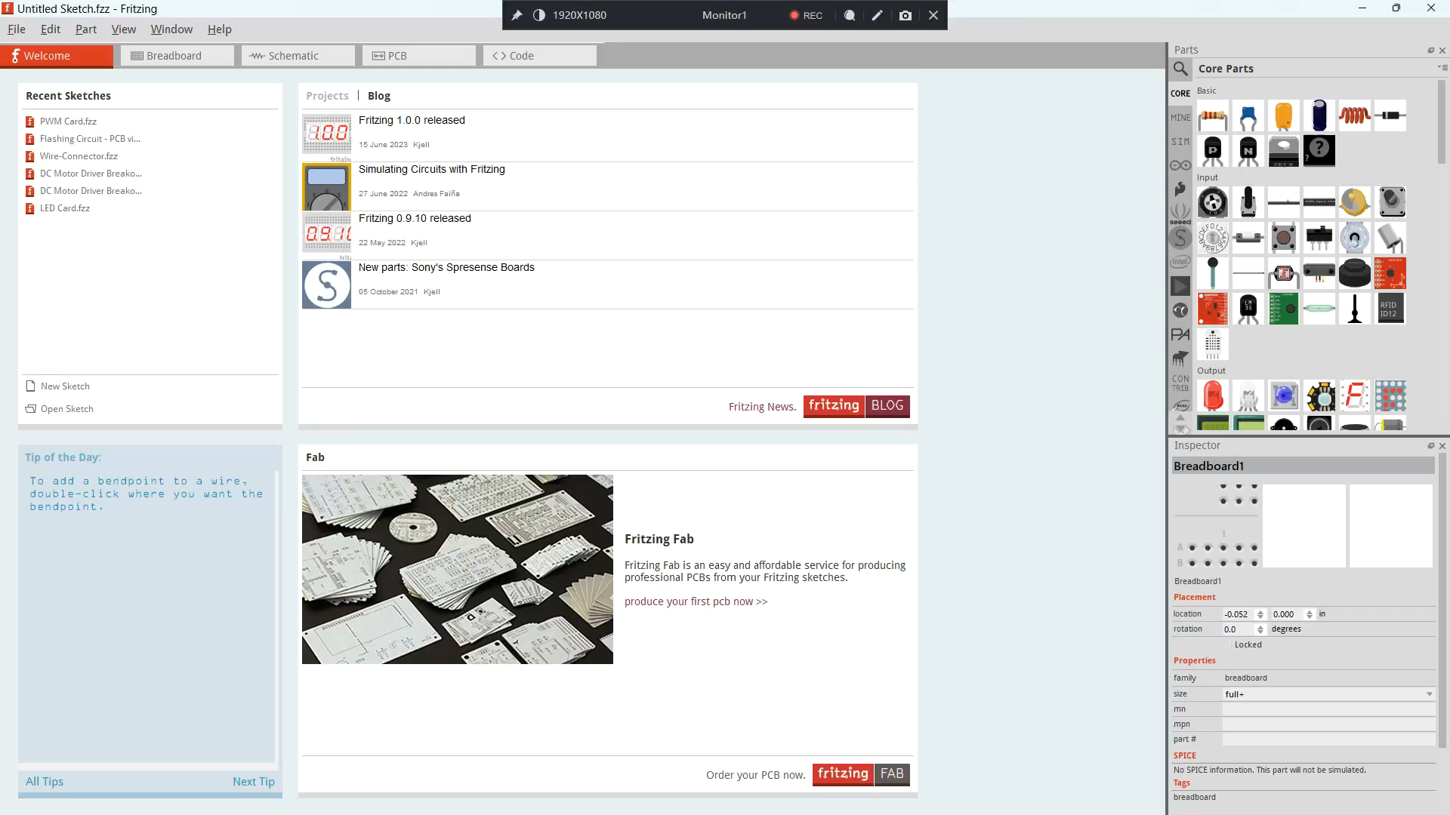
Fritzing File menu
File menu provides basic functions:
New, Open, Open Recent Files
Save, Save As…, Quit
Print (selected design)
Revert – restore last saved
Order a PCB… (Order PCB from ANSLER, $$$)
Open Examples
Function Selection | Use | Comment
Export: Production | Create Gerber files | Required for PCB fabrication
Export: As Image | Create image files of designs | Breadboard, Schematic, or PCB
Export: List of Parts (BOM) | List of parts and details | HTML web page

Slide 14
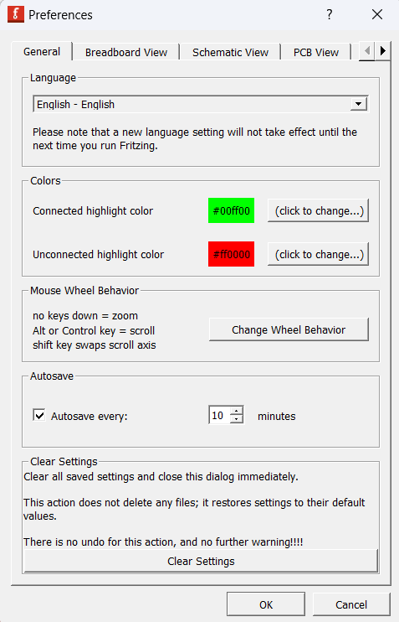
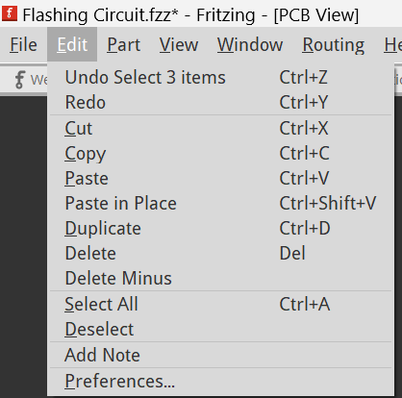
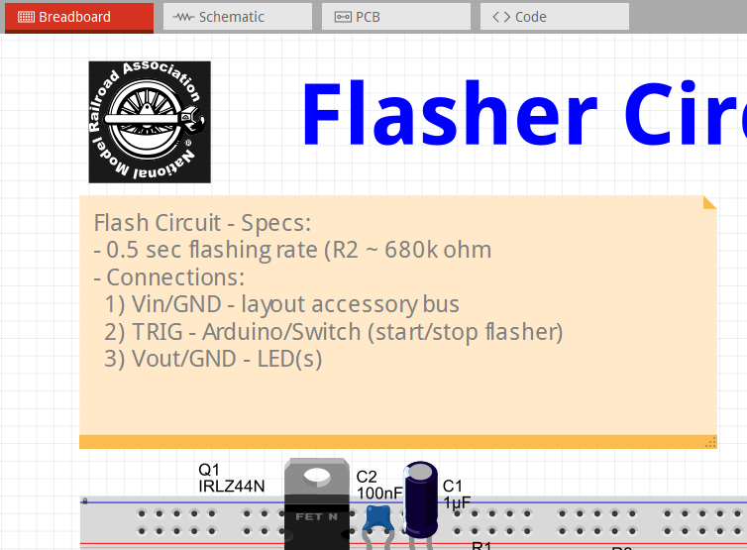
Fritzing Edit menu
Edit menu provides basic editing functions a selected component part or wire
Add a Note – for documentation
Preferences
Function Selection | Use | Comment
Set curvy lines | Allows lines with curves | Tip: use only with breadboard
Autosave | Provides recovery | Important since Fritzing can crash

Slide 15
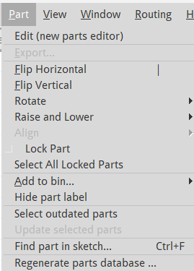
Fritzing Part MENU
Part menu provides basic functions for working with components and wires
Function Selection | Use | Comment
Edit (new parts editor | Modify existing parts | Advanced, not used often
Flip Horizontal / Flip Vertical | Flip part in place | Works with only some parts
Rotate | Rotate selection in place | Used frequently, same as icon in lower left of main window
Raise and Lower | changes selection’s view layer | Works with only some parts
Lock Part | Lock a part or background from being moved or edited | Very useful for background, notes, PCB image
Select All Locked Parts |  | Used before unlocking all parts
Add to bin… | Adds selected part to MINE bin | Use for quick reuse of common parts
Hide part label | Remove label from view | Useful temporarily to gain access to connection points

Slide 16
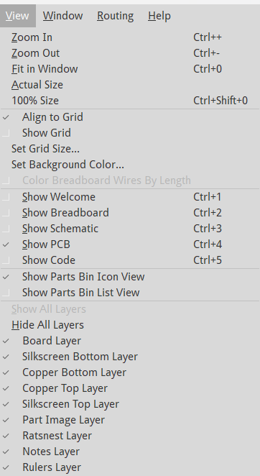
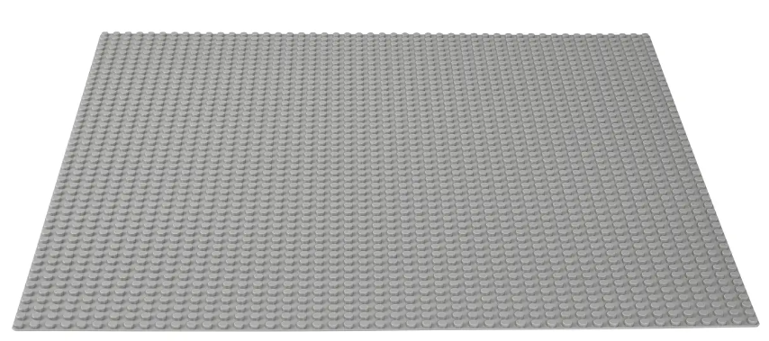
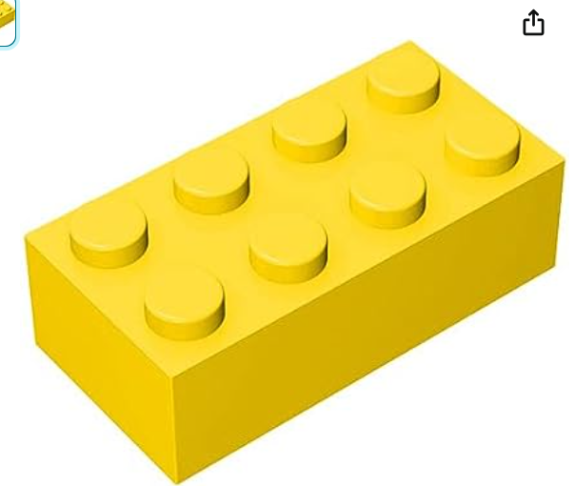
Fritzing View menu
View menu is used to select windows to be displayed and change them
Function Selection | Use | Comment
Zoom In/Out | Zoom | Position cursor, then zoom in/out. Also, use mouse scroll wheel
Fit in Window | Fits everything to window | Very useful
Actual Size | Shows PCB size | Printed PCB is also actual size
Align to Grid | Snap parts, connections to grid points | Use in most cases, unless very small changes are needed
Show Grid |  | Not very useful, just snap to grid
Set Grid Size |  | 0.1” common for most parts. Use 0.05” or 0.025 for traces on dense PCB
Show xxxx | Change window view | Same as clicking on tabs
Best Practices:
Use mouse with scroll wheel for fast zoom in/out
Zoom in/out occurs at cursor is location
Use Ctrl+0 (zero) to fit design to screen
Set grid size to be 0.1” to begin with, then modify to 0.05” or 0.025” for complex PCB designs
Typically don’t hide layers

Slide 17
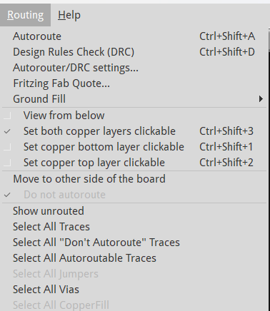
Fritzing Routing MENU
Routing menu is used for working with wires
Function Selection | Use | Comment
Autoroute | Routes (creates) wires from Ratsnest lines | Useful to initially create a wire(s) after placing parts
Design Rules Check (DRC) | Use to valid PCB design | Required before fabrication
Autorouter/DRC settings | Set to Professional
Fritzing Fab Quote | Getting fabrication quote | Not used
Ground Fill | Create ground copper plane to all GND connections | Not used, difficult to verify if connections are made
View from Below / Top | Change user view to top or bottom of PCB | Use to work with top / bottom of PCB
Set ‘xxx layer’ clickable | Affects which layer you can click on | Typically set to ‘both’, change if having problems selecting connections
Select All Traces | Selects all PCB traces | Use to change all trace widths
Best Practices:
In PCB view, use icons at bottom to Rotate, set Top/Bottom view and layers to view
Learn Ctrl+Shift+D for running DRC
To ease selecting a wire, make only one layer clickable
Use Select All Traces to change all wires to the same width (new wires always default to 24mil width)
Use 8 mil width to run between 0.1” spaced holes

Slide 18
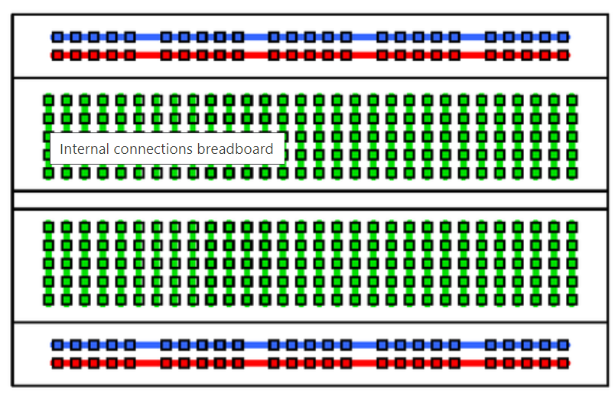
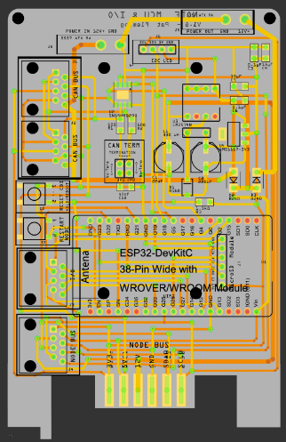
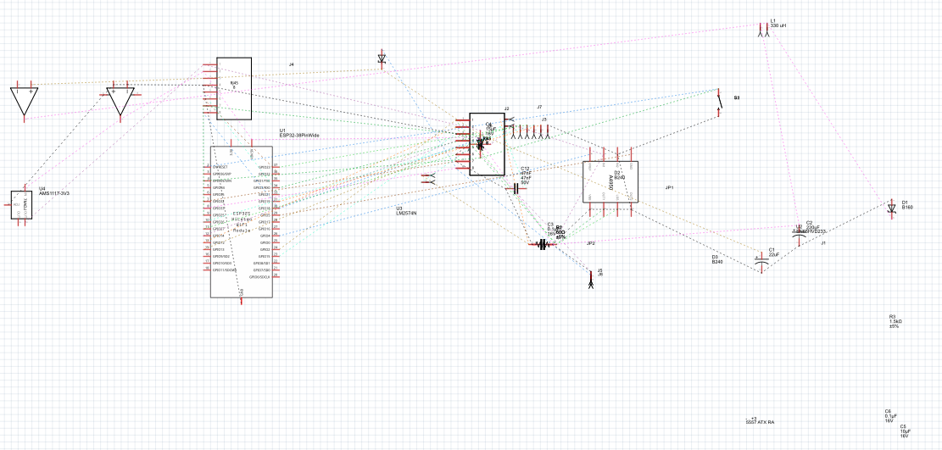
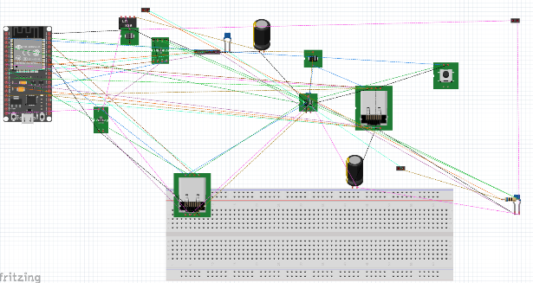
Circuit Designs Part and WIRING placement required for each design
Placing parts and running wire connections is required for each of the 3 designs
Parts need to be arranged for each design in way that make most sense for that type of design
For example:
Parts are arranged on a breadboard based on the breadboard built-in connections
Parts on a PCB are arranged based on PCB size, routing, etc..
Below is an example of a completed PCB design and the default schematic and breadboard designs
Component and wiring routing are needed
Ratsnest lines can be converted to wires individually or all at once

Slide 19
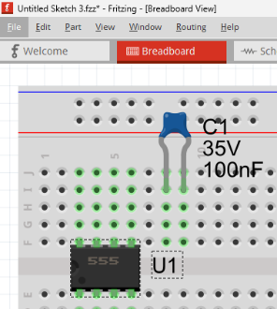
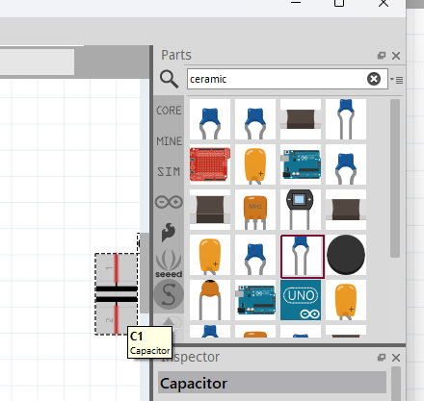
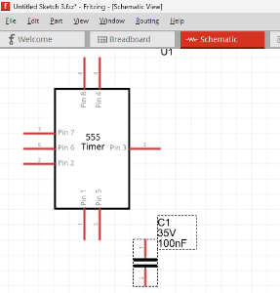
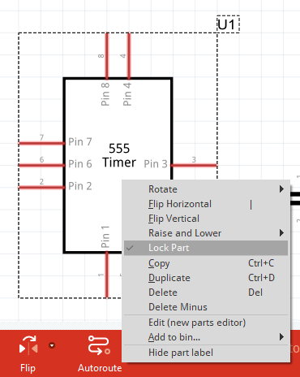
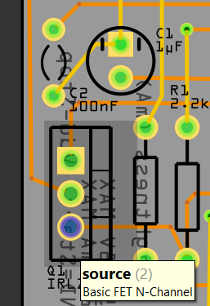
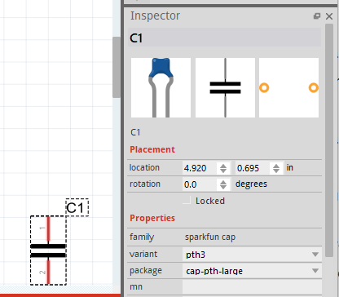
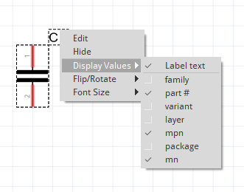
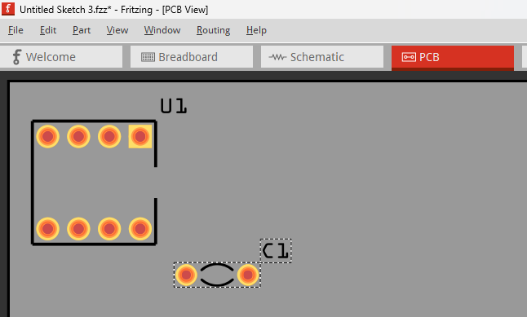
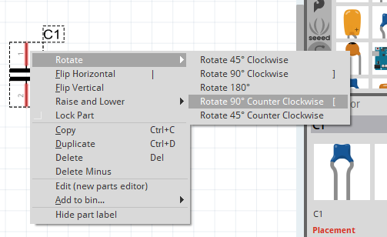
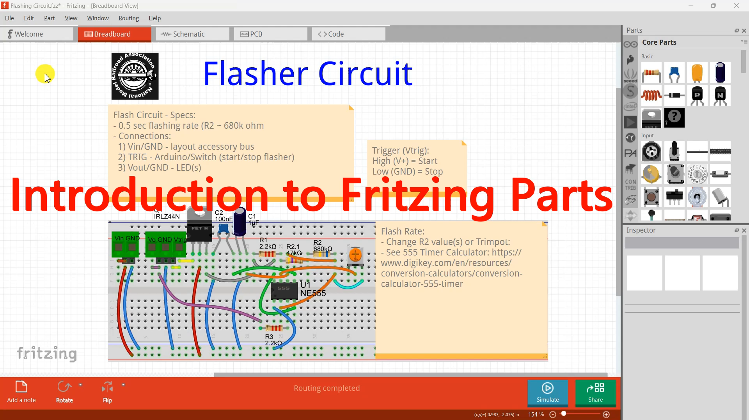
Fritzing Working with Parts
Working with parts is similar for Fritzing Breadboard, Schematic and PCB designs
After searching for a part in a bin in the Part Palette window, they can be dragged from the bin onto the design
To provide easier connections, parts can be rotated using the icon at bottom of the main window or right clicking the part and selecting from the menu
Part properties can be updated in the Inspection Palette
Part labels can be moved, rotated, duplicated, copied/pasted, deleted, and sized with selected part information by right clicking the label and selecting from the menu
Parts can be locked to prevent changes
In Breadboard and PCB designs, hovering over pins of a part will display the pin’s description
Demonstration – creating parts (video)
Notes:
<Intro to video>
Welcome to this brief video where we'll explore using Fritzing to position parts in a circuit design.
The process of part placement remains consistent throughout the breadboard, schematic, and PCB views. Working with parts involves searching for the specific part to incorporate into the design, followed by positioning the part correctly and finally managing its label.
Note that in most cases, parts need to be positioned in a way that allows for connections between them, which often requires rotating the part. For documentation, part label texts is usually added, minimized, rotated, and positioned for optimal visibility and readability. Part labels usually limit information to what is required for the design. For example, on a PCB a resistor part label would have the resistance and if the part is being referenced, a part designator like R1.
In the schematic view, we will add two parts, enabling us to establish connections at a later stage.
Let's get started!
To incorporate the flasher circuit into our project, we will begin by searching for each of the parts. Once found, we will add them to the schematic view and proceed to modify their part information and labels as needed.
To begin, let's add a NE555 Timer IC part to the schematic:
Start Fritzing and select File and then New to create a new sketch.
Navigate to the Parts palette window.
Scroll to the top of the bin list and click on the Magnifying Glass icon to activate the search feature.
Type “555" in the search input field and press Enter to initiate the search.
Locate the 555 Timer IC variant for the project, which should be the first part displayed in the search results. It is black, with ‘555’ on the IC.
Drag the 555 Timer IC part from the Parts palette window and drop it into the central area of the schematic window.
Press Ctrl++ to zoom in. Optionally, from the top menu select View, then Zoom in.
Click on the rotate icon located at the bottom of the window to rotate it upright.
To prevent accidental movement or deletion, lock the part. This can be done for any component in any view within Fritzing.
Tip: Locking is typically done for important components after they have been positioned and edited.
By following these steps, you can successfully add the NE555 Timer IC part to the schematic, adjust its orientation, position the label, and lock it in place.
-----------------------
< updating part information>
To modify the part's information, follow these steps:
Select the 555 Timer IC part in the Schematic view.
Adjust the position of the label beneath the part by left clicking the label and dragging it.
Navigate to the Inspector palette window.
In the Inspector palette, locate the package type field and choose 'DIP8 (THT)'. This selection signifies that the IC has eight legs and utilizes Through-Hole Technology (THT).
Find the 'mn' field in the Inspector palette and enter ‘NE555' as the desired value.
By completing these steps, you can successfully update the information of the selected part, including specifying the package type as 'DIP8 (THT)' and setting the 'mn' field to ‘NE555’.
-----------------------
<updating part label>
When a part is placed in the schematic window, its label is initially shown by default. You have the option to change the position, orientation, size, and information of the label. To make these changes, select the part and then right-click on the label to display a menu of options. By default, part labels display the Text value that was specified when the part was initially created. These text values typically follow industry conventions based on the type of part, such as 'U' for an IC, 'R' for a resistor, 'Q' for a transistor, and 'C' for a capacitor. Fritzing automatically adds a unique number to ensure the text is unique. Modifying part labels is important to create accurate and user-friendly information for circuit users.
To update the part label, follow these steps:
Select the part in the schematic.
Right-click on the part's label and choose "Display Values" from the context menu.
From the list of options, select 'mn' to display the part's manufacture number.
Right-click on the label again, select "Font Size," and choose "Tiny." This is the smallest font size available, which helps prevent text overlap on the breadboard, schematic, and PCB views.
If needed, you can rotate the label by right-clicking on it, selecting "Flip/Rotate," and choosing one of the rotation options from the menu.
Grab the part label and drag it to the lower right of the 555 Timer IC part.
Please note that you need to select the part first before you can work with its label.
By following these steps, you can successfully update the part label, including displaying the manufacture number, adjusting the font size, rotating the label if necessary, and repositioning it to the desired location.
----------------------------
Let's begin by adding the second part of the flash circuit, which is a ceramic capacitor, to the schematic:
Open the Parts palette window.
Scroll to the top of the bin list and click on the Magnifying Glass icon to activate the search input field.
Enter "ceramic" in the search field and press Enter to search for the part. The ceramic capacitor we need should be the last part shown in the results.
Drag the capacitor part from the Parts palette window and place it in the central area of the schematic window.
While the part is still selected, right-click on the rotate icon located at the bottom of the window to rotate it upright.
Drag the label and position it to the lower right of the 555 Timer IC.
If necessary, rotate the part by clicking the Rotate icon once more, while it is still selected.
Now, let's update the information for the part:
Select the ceramic capacitor part.
Open the Inspector palette window.
In the Inspector palette, locate the package field and choose '200 mil (THT, multilayer)'. This selection indicates that the capacitor has a 0.2" size and utilizes Through-Hole Technology (THT).
In the capacitance field, select 100nF.
Next, we'll update the part label as follows:
With the part selected, right-click on the part's label and choose "Display Values" from the context menu.
From the list of options, select 'mn' to display the part's manufacture number.
Right-click on the label again, select "Font Size," and choose "Tiny". This is the smallest font size available and helps prevent text overlap on the breadboard, schematic, and PCB views.
If necessary, rotate the label by right-clicking on it, selecting "Flip/Rotate," and choosing one of the rotation options from the menu.
Drag the part label to the lower right of the 555 Timer IC part.
Please note that you need to select the part first before you can work with its label.
By following these instructions, you can successfully add the ceramic capacitor, update its information, and modify the part label according to the provided guidelines.
To select components within each view, you can simply left-click on the item. If you need to select multiple components, hold down the CTRL key while left-clicking. Additionally, you can left-click and drag the mouse over an area to select multiple items within that area. To deselect a selected object, you can hold down the CTRL key and left-click on it.
Fritzing also provides a feature that allows us to duplicate or copy parts from one sketch to another. By selecting the desired components and using the familiar Windows copy and paste actions, we can effortlessly replicate elements in our designs. This functionality is particularly valuable when we want to reuse designs across sketches or create duplicates of similar parts.
For instance, let's say we need to add a second ceramic capacitor to our design. We can easily achieve this by copying the existing capacitor and pasting it into the desired location. If necessary, we can also adjust its capacitance using the Inspector palette.
The Part palette offers a convenient feature with a dedicated MINE bin situated beneath the search magnifying icon. To utilize this feature, simply select a part within the design or from another bin and right-click on it to add it to the MINE bin. This proves to be highly advantageous for frequently used parts, those that are challenging to find, components imported from the internet, or ones generated through the Fritzing Parts Editor.
Once a part is added to the MINE bin, it becomes readily available for future searches. This capability ensures quicker access to commonly employed parts, streamlining the design process and saving valuable time during circuit creation.
Now that we have placed our first two parts on the schematic, let's explore how to add lines to establish connections between them.

Slide 20
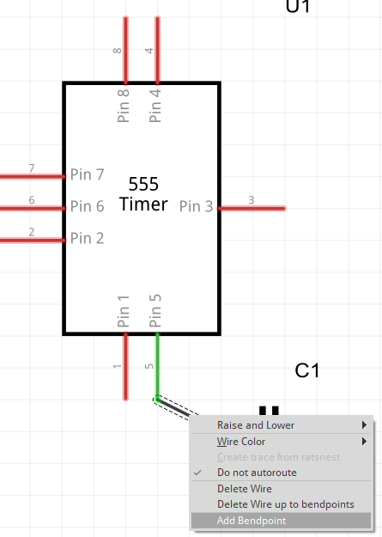








Fritzing Working with Wires
Working with parts is similar for Fritzing Breadboard, Schematic and PCB designs
Wires can be created by left-clicking on a pin and dragging a wire to another object (pin, bend point)
Connecting a wire changes the color of connections from red to green
Moving a part causes the wire to remain connected and change length or direction
Hovering over a wire causes the wire to change color, indicating that a left-click will select the wire
Right-click a selected wire and select Add Bendpoint to allow for a wire to be bent later by dragging the bend point
Selecting an end or mid point of the wire, highlights all of the connections within the entire circuit
Delete a selected wire by pressing the Delete key, or right-click and select Delete
Disconnect and move a wire endpoint by hovering over the endpoint until it turns blue, then drag away from connection
Demonstration - Adding a wire (video)
Demonstration - Convert Ratsnest Lines to Wires (video)
Notes:
When working on your circuit, connecting components and working with wires will be a significant part of the process. We need to cover the similarities and specifics of working with connections and wires in the Breadboard, Schematic, and PCB views before proceeding further.
Now, let's learn about wires by adding our first one to the schematic view:
Start in the Schematic view.
Create a single wire by left-clicking on pin 5 of the 555 Timer and dragging the connection to pin 1 of the capacitor.
When you select a connection point of a part, you will notice that its color changes to blue. This visual indication helps identify the selected connection. If a connector is not selected, the connection will either not be drawn or it will not establish a connection with the part.
To verify that the wire is connected to the two parts, you can select and move the capacitor to see the wire. Additionally, notice that the legs of both parts turn green instead of red, indicating a successful connection.
Hovering the cursor over a wire will cause the wire to turn gray. By left-clicking on the wire, you can select it, which will be indicated by a dotted line appearing around the wire.
If you want to delete a wire, you can either select the wire and press the Delete key or right-click on the wire and choose Delete from the context menu. There is also an option to Delete Wire up to Bendpoints.
In both the Breadboard and Schematic views, you can right-click on a wire and select Wire Color, then choose a color to change the wire's color. Typically, black or blue is used for wires to ground, red for wires to voltage, and yellow for signal or control wires.
By left-clicking on a wire and dragging it from the middle, you can add a Bendpoint to allow for rerouting the wire. Note that in a both PCB and schematic designs, wires usually run vertically or horizontally rather than diagonally. To remove a Bendpoint, double-click on it. Right-clicking on a wire will display a menu with options for adding and deleting a Bendpoint.
To move the end of a wire, hover the cursor over the end of the wire. This action causes the connection point to turn blue, indicating that you can drag the wire end away from the connection.
Please note that selecting the end of a connected wire may not be easily accomplished. To facilitate this, you can try one of the following methods to select the connection’s end point:
Zoom in on the area by using the scroll wheel on the mouse, pressing Ctrl++ on the keyboard, or selecting View from the menu and then choosing Scroll In.
Create a Bendpoint near the end of the wire and then delete the wire leading to that end point. This will allow you to easily move the end point.
Right-click on a part and select "Hide Part Silkscreen." This can help clear the view and make it easier to select the wire end.
Display only the layer the part is on by clicking the Layers icon at the bottom of the screen. This can simplify the view and make it easier to select the wire end.
By following these instructions, you can familiarize yourself with the process of working with connections and wires in the different views. This will help you effectively create and manage your circuit connections.
--------------------------------
If we switch to the Breadboard view, Fritzing represents the new wire as a Ratsnest Line, which signifies a connection line. To convert this line into a wire, you can right-click on the wire and select "Create wire from Ratsnest."
Additionally, you have the option to make the wire curve, resembling a real wire mounted on a breadboard. To enable this feature, follow these steps:
Click on "Edit" in the top menu.
Select "Preferences."
Click on the "Breadboard" tab.
Check the box for "Curvy wires and legs."
Once this preference is set, you can left-click anywhere on the line and drag the Bendpoint to create a curve. If you are not satisfied with the resulting curve, right-click on the wire and choose "Straighten Curve" to straighten it.
-----------------------------------
If we switch to the PCB view, Fritzing once again represents the connection from the Schematic view as a Ratsnest Line. To convert this Ratsnest Line into a wire that will become a copper "trace" on the PCB, you have two methods:
To convert a single Ratsnest Line at a time, right-click on the Ratsnest line and select "Create wire from Ratsnest," similar to what was done in the Breadboard view.
Alternatively, you can click on "Routing" in the top menu bar and select "Autoroute." Autoroute not only converts all Ratsnest Lines to wires but also routes them for production readiness. We will discuss this in more detail when we cover PCB layout in the PCB view later on.
In the PCB view:
Wires become copper "traces" connecting components on the PCB. You can configure the width of the wire, with narrower widths allowing for more traces and reduced PCB size, while wider widths support higher current.
Fritzing supports PCBs with two layers of copper, positioned on the top and bottom of the board. Each wire needs to be placed on either the top or bottom layer. You can achieve this by right-clicking on the wire and selecting "Move to Bottom" or "Move to Top." Alternatively, you can update the "pcb-layer" field in the Inspector palette window to position the wire.
Wires can be rerouted by left-clicking in the middle of the wire to create a Bendpoint that can be moved. On a PCB, wires typically run vertically or horizontally.

Slide 21




Fritzing Working with Wires - DRC
PCB Fabrication Guidelines:
Specific rules for wire traces on the PCB surface
Design Rule Check (DRC):
Guidelines for design and manufacturing standards
Ensures adherence to quality benchmarks
DRC in PCB Design Software:
Integrated DRC service for pre-fabrication review
DRC Execution in Fritzing:
Access via Routing > Design Rules Check or Ctrl+Shift+D
Identifies all errors, highlighting them all in red
Error Rectification:
Selected error description causes problem to be highlighted in yellow
Errors must be fixed before fabrication
Example errors:
Crossing traces on same copper layer
Close proximity to component holes
Example errors corrected
Best Practices:
Utilize DRC regularly to minimize the occurrence of errors
Adjust the grid size to 0.025 in for precise trace rerouting
Ensure uniform trace direction on all copper layers during routing (e.g. vertical on top, horizonal on bottom)
Notes:
PCB fabrication involves a vital set of guidelines known as Design Rule Check (DRC), ensuring a smooth manufacturing process without hitches.
DRC checks are a standard feature in PCB design software, like Fritzing, providing a way to validate PCB designs.
To initiate DRC in Fritzing's PCB view, select "Route" and then "Design Rule Check". Alternatively, use the shortcut Ctrl+Shift+D.
Following DRC, a report highlights errors demanding correction prior to fabrication. These problematic areas are indicated in red on the PCB. However, the red markings can be quite small and challenging to discern in certain cases.
By selecting an error in the report, the corresponding issue on the PCB is highlighted in red. Sometimes, the error descriptions might be complex to decipher.
In an illustrative instance, there are two traces intersecting on a single copper layer. To resolve this, one of the traces should be relocated to a different layer. Another error highlights a trace positioned too close to the holes meant for the 555 Timer IC. Moving this trace farther from the holes is necessary.
Upon implementing the necessary alterations to the traces and conducting another DRC check, a message indicating successful completion is shown.
Here are a few recommended practices:
- Conduct regular DRC checks to keep errors in check, facilitating their resolution and trace rerouting
- Employ a finer grid size to allow for tighter trace placement. A grid size of 0.025 (one-fourth of 0.1 inch) aligns with 0.1 inch components
- Consistently orient traces in the same direction across all copper layers. This approach streamlines error correction and trace tracking

Slide 22
Flasher Circuit - Example

Slide 23
Flasher Circuit Example Design Considerations
Size / Shape
Mounting
How will the PCB be mounted?
Affects location of drill holes or board dimensions
i.e. foam tape, screws, DIN rail, PCB housing
Terminal connections
What type of connection; solder pad, solder hole, screw/spring terminal, CAT cable, or pin header
What size of wire will be used
Placement of connection points to ease access of wiring
Cost
PCB Production costs
Generally low cost (JLCPCB)
Determined by complexity, size and weight
Component costs
Consider using components that are readily available for awhile and mass produced
i.e. available in AliExpress.com (China based)
Multiple circuits per board to lower costs, reduce space and ease of wiring

Slide 24
Flasher Circuit Example Requirements
Functional
Standalone flasher circuit to be used with train layout
Controlled (start/stop) by switch, button or Arduino (GPIO pin)
500 msec flash rate
Power by layout’s accessory bus (12v)
Flash 1 or 2 LED(s) independently
Current-limiting resistors (protect LED)
Screw/spring connectors or input/outputs
Circuit Design
Breadboard, Schematic, and PCB Designs
Based on 555 Timer (Wikipedia definition)
Astable mode (Free running) – continuous rectangular wave output signal
Circuit configuration based on 555 Timer Calculator
PCB
50mm height to fit into UM50 PCB housing
Ease of Implementation (design / build)
Designed using Fritzing
Use 555 Timer IC
Use PTH components for ease of soldering
Screw (or spring) terminal connections (solid wire) & solder pads (stranded wire)
Low Cost (parts / fabrication)
1 or 2 layers (note: Fritzing only supports 1 or 2 layers)
Minimal in size (low cost)

Slide 25


Flasher Circuit example Schematic Modifications
Schematic source: https://www.digikey.com/en/resources/conversion-calculators/conversion-calculator-555-timer
Astable Mode: continuous rectangular wave form
Modifications:
Added missing pin 5 -> GND
Based on 500 msec on/off per sec flash rate (ref 555 Timer Calculator)
R1 = 680 ohm
R2 = 727k ohm (680k ohm + 47k ohm) OR Trimpot (0-2M ohm)
C1 = 1uF (creates 1 sec cycles)
Added optional 2M trimpot to adjust flasher rate
Added transistor to allow switching on/off using low voltage
Added connectors; header holes, screw/spring terminals
Power (Vin & GND) to layout accessory bus (5-16V)
Trigger (Vtrigger): to 5-16V (Arduino or button)
Output (Vout & GND): LED /w 2.2K resistor
Added C3 100nF between Vin and GND

Slide 26



Flasher Circuit example Component Selection
Component | Cost (/w link) | Comments
Resistor – 680, 680k, 2.2k, 47k | Low (<$1.00) | 100 pieces, or kits of assorted types
Transistor – IRLZ44N | Low (<$0.35) | 10 pieces
Capacitor – 1uF 50V | Low (<$0.07) | 50 pieces
Capacitor – 100nF | Low (<$0.03) | 100 pieces
Timer IC – NE555 | Low (<$0.20) | 20 pieces
Terminal – Spring | Low (<$0.40) | Sets of 2 or 3 connectors
Potentiometer (Trimpot) | Low (<$0.20)
PCB | JLCPCB ~ $1.00 | Minimal lot of 5
PCB Housing | Low (<$1 / ft) | Min of 1 meter
Best Practices:
Consider SMD vs PTH to reduce costs
Verify part package type is readily available and low cost (i.e. NE555 SOP-8 is lower cost than DIP-8 on AliExpress)
Search Digikey to find PDF of the IC’s Technical DataSheet (TDS) – ‘Digikey NE555’ and NE555 TDS
TDS provides:
package types, part number
Pin names, purpose, V/A limits, spacing
Application/test circuit designs

Slide 27

Flasher Circuit Example Breadboard VIEW
Best Practices:
Document using Logo (text) and notes
Color wires into groups:
Black/blue for GND, red voltage, etc..
Place component close to wires
Curve wires to make connection visible
Leverage V and GND on breadboard edge
One component or wire per hole
Leverage breadboard built-in connections
Component | Usage
Breadboard | Place to put parts, different sizes
Logo (Image) | Custom Images
Logo (Text) | Label / Identifiers
Notes | Documentation
Parts | Electronic parts
Wire | Connections
Logo (Image)
Logo (Text)
Notes
Parts
Breadboard
Wires

Slide 28

Flasher Circuit Example Schematic VIEW
Schematic Frame
Best Practices:
Summary of Circuit Symbols used in schematics
Circuit Symbols (Talking Electronics)
Schematic Design Rules (recommendations)
Use Net Labels to create virtual connections for:
V and GND
Common connections
Connections across schematic pages
Route connections vertical or horizontal
Use multiple schematic frames (Sheet) for:
Separation into logical blocks (i.e. MCU (Arduino), power supply, IC, etc..)
Provide notes, comments, revision history
Write labels (names, etc.):
Horizontally
Place outside of the symbol
Use standardized part designators (created automatically Fritzing for most parts)
Object | Comments
Schematic Frame | Project information, outline
Net Label | Virtual connections between wires
Timer IC | NE555 part from catalog
Capacitors (C1-C3) | Parts from catalog
Resistors (R1-R3) / Trimpot (U2) | Parts from catalog
Spring Terminals | Parts from catalog
Transistor (Q1) | Part from catalog
Connections between parts | Generates Ratsnest lines
Transistor
Net Labels
Timer IC
Resistors
Capacitor
Terminals
Connectors
Net Labels
Notes:
For example, since we have a published schematic of a Flasher Circuit using the 555 Timer IC, we’ll start by selecting the Schematic View.
The following steps are presented in the linked video for creating a schematic of the Flasher Circuit.
Start by adding each of the Flasher circuit component parts by locating and dragging each part from part bins to the sc hematic page.
For schematics, use Net Labels to create virtual wires helps reduce the number of wires shown in the schematic. Net Labels typically for common connections such as V and GND.
Let’s now create the Flasher circuit’s schematic, using parts from the Parts palette window.
Add a ILZ44N transistor by searching for ‘FET’ in the Parts palette window. FET is a specific type of transistor.
Select the first part shown in the Parts palette window and drag and place it left of the 555 IC in the circuit window
Update the part’s information
Select the part and navigate to the Inspection palette window
Select ‘TO220 (THT)’ for the package type. TO220 is an 3 leg transistor package and THT means Through Hole Technology IC.
Enter ‘IRLZ44N’ in the ‘mn’ field
Update the part’s label
Select the transistor part again and right click the part’s label.
From the selection window select Display Values and then select ‘mn’ from the list.
Right click again and select Font Size and select Tiny.
Left click to position the part’s label below the part.
Add the first resistor by searching for ‘resistor’ and selecting the first one shown in the Parts palette window. Drag and drop this part to the schematic window. In the Inspector window, change the resistor’s value to 47k ohms by selecting within the Resistance field. Change the package to THT for Through Hole Technology and pin spacing to 400 mil. Note 400 mil is 400 thousandths of an inch. Rotate and connect this part to 555 Timer IC pin 7. Next edit the part’s description by first selecting the part and then right clicking on the description. Update the part description to include only the part name and resistance. Edit the part name to R2.1 and place the description above the part.
Create a 2nd resistor using copy and paste. Using the Inspector palette window, change part’s package to THT, pin spacing to 400 mil and resistance to 680k ohms. Rotate and connect to pin 6 of the 555 Timer IC.
Create and connect to pin 2 of the transistor the 3rd and rotate vertically. Change the part’s specifications to THT, 400 mil and 2.2k ohms. Update the part’s label.

Slide 29

Flasher Circuit Example PCB VIEW
Hole
PCB Image
Object | Comments
PCB Image (gray area, created by default) | PCB board outline (required) 1 per PCB, everything fits within Set size by dragging corner or using Inspector palette
Hole (search for ‘hole’, yellow circle) | Drill holes thru board for screws Set diameter in Inspector palette
Parts - Resistors, Capacitors, Transistor, Trimpot, NE555 Timer IC (black outline on silkscreen) | From parts catalog Updated labels Positioned & Rotated, Pin 1 has square copper
Wires (yellow on top, orange on bottom) | Converted Ratsnest Lines, Rerouted for DRC Set layer and width in Inspector palette
Via (small green circle with black center, right click bend point & convert to via ) | Hole with copper to connect top wire with bottom wire
Logo (search for ‘logo’, select part for PCB) | Text on top/bottom silkscreens Right click to set the layer or use Inspector palette
Best Practices:
Use consistent grid size matched to components, usually multiple of 0.1” (i.e. 0.05”, 025”)
Turn off “Align To Grid” in View menu to make very small adjustments
Avoid auto routing (result in complex and confusing wire routes)
Place connections near edges with considerations for external wiring routing
Group similar components
Place IC towards center because of multiple connections and routing
Write labels (names, etc.) for parts
Display part designators (R1, C1, etc..) and
Position horizontally, placed outside of the parts silkscreen
Use standardized part designators (created automatically Fritzing for most parts)
Place on back documentation: origin, version, input/output requirements
Route wires vertical and horizontal on separate copper layers (front/back)
Using SMD parts can save room and ease routing of traces
Place SMD components on same side (top), best for reflow soldering
Via
Parts
Wire (Bottom)
Wire (Top)
Logo / Text (Bottom)
Notes:
For example, since we have a published schematic of a Flasher Circuit using the 555 Timer IC, we’ll start by selecting the Schematic View.
The following steps are presented in the linked video for creating a schematic of the Flasher Circuit.
Start by adding each of the Flasher circuit component parts by locating and dragging each part from part bins to the sc hematic page.
For schematics, use Net Labels to create virtual wires helps reduce the number of wires shown in the schematic. Net Labels typically for common connections such as V and GND.
Let’s now create the Flasher circuit’s schematic, using parts from the Parts palette window.
Add a ILZ44N transistor by searching for ‘FET’ in the Parts palette window. FET is a specific type of transistor.
Select the first part shown in the Parts palette window and drag and place it left of the 555 IC in the circuit window
Update the part’s information
Select the part and navigate to the Inspection palette window
Select ‘TO220 (THT)’ for the package type. TO220 is an 3 leg transistor package and THT means Through Hole Technology IC.
Enter ‘IRLZ44N’ in the ‘mn’ field
Update the part’s label
Select the transistor part again and right click the part’s label.
From the selection window select Display Values and then select ‘mn’ from the list.
Right click again and select Font Size and select Tiny.
Left click to position the part’s label below the part.
Add the first resistor by searching for ‘resistor’ and selecting the first one shown in the Parts palette window. Drag and drop this part to the schematic window. In the Inspector window, change the resistor’s value to 47k ohms by selecting within the Resistance field. Change the package to THT for Through Hole Technology and pin spacing to 400 mil. Note 400 mil is 400 thousandths of an inch. Rotate and connect this part to 555 Timer IC pin 7. Next edit the part’s description by first selecting the part and then right clicking on the description. Update the part description to include only the part name and resistance. Edit the part name to R2.1 and place the description above the part.
Create a 2nd resistor using copy and paste. Using the Inspector palette window, change part’s package to THT, pin spacing to 400 mil and resistance to 680k ohms. Rotate and connect to pin 6 of the 555 Timer IC.
Create and connect to pin 2 of the transistor the 3rd and rotate vertically. Change the part’s specifications to THT, 400 mil and 2.2k ohms. Update the part’s label.

Slide 30






Flasher Circuit Example PCB VIEW – part Placement (PTH)
30mm
PCB resized to 50mm x 30mm for UM50 PCB housing
3.2mm drill holes in each corner for mounting
Connectors at top edge (wire insert from top)
555 Timer IC centered on right edge, rotated to shorten wires
Transistor placed on left edge, rotated
Trim pot placed at bottom for easy access, rotated
Part labels positioned upright /w identifier & values
Top copper – vertical traces (yellow)
Bottom copper – horizontal traces (orange)
Text labels on back of board
50mm
Notes:
Let's go over the arrangement of components for the Flasher Circuit PCB, considering technical details:
1. As per the specified criteria, the PCB board must fit into a UM50 PCB housing, necessitating the adjustment of the board's height to 50mm. To provide ample space for component placement, the width is set at 30mm. To achieve this resizing, access the board image (gray area) and modify the shape parameters within the Inspector palette window.
2. Four drill holes with a diameter of 3.2mm are positioned in the corners of the PCB to accommodate the attachment of 3mm screws or standoffs. The drill hole component can be located by searching for 'hole' and can be placed by dragging the 'yellow ring' icon onto the PCB. Using the Inspector Palette, resize the hole diameter to 3.2mm with a ring thickness of 0.
3. Install and orientate a set of 2 and 3 pin headers, along with screw/spring terminal connectors at the upper section of the PCB. This configuration enables users to connect wires in an upward direction, away from the housing. These connectors are appropriately labeled to signify their purpose. To establish connectivity, traces are added to link the pin header connectors with the screw/spring connectors.
4. Position the 555 Timer IC on the right side of the board and adjust its orientation to optimize direct connections with other components.
5. Situate the Transistor on the right side of the board and rotate it to facilitate direct connections.
6. Place the trim pot in the lower right corner, employing rotation to allow convenient access to the trim knob.
7. Provide labels for all parts. Each label is to be positioned near its corresponding component, displaying the designator and part value. Make sure to adjust the orientation of the labels in the same direction for readability.
8. Convert each Ratsnest Line into a trace by clicking on it. Right click a trace and add bendpoints along each trace's path to establish routing. Vertical traces are positioned on the top copper layer, while horizontal traces are located on the bottom layer. Bendpoints are transformed into vias, enabling traces to traverse between the top and bottom layers. Note that a via is a copper lined hole connecting top and bottom traces.
10. To add text on the back of the PCB, employ the 'logo' component. Search for the 'logo' part and choose the one specifically designed for text on the silkscreen layer. Ensure not to select an image intended for the copper layer. This will allow appropriate textual information to be included on the silkscreen layer located on the PCB’s back surface.

Slide 31

Flasher Circuit Example CODE VIEW
Code tab provides a basic Arduino IDE
Buttons
New / Open - create Arduino code (sketch)
Save - save and name *.ino file
Arduino Options
Platform
Board
Port
Serial Monitor
click to view Arduino serial monitor input/output
Upload
Compile/Upload firmware to Arduino
Example shown:
Sketch for Flasher Circuit
Defines input pin for a button
Defines output pin connected to trigger
setup()
sets input / output mode of pins
loop()
Checks for button being pressed
Set output pin High while pressed

Slide 32
Ordering a PCB

Slide 33


Ordering a PCB verification
Before ordering
Print PCB (from Fritzing menu: File -> Print)
Prints to actual size
Check component placement (clearances)
Include screws in holes, terminals, etc...
Select a fabricator
Multiple options for PCB fabrication: JLCPCB, PCBWay, etc....
JLCPCB provides high quality and low cost fabrication of PCBs
Cost vs time: 2-3 week delivery
Notes:
Make sure the components fit correctly on your PCB before placing an order. You can do this by using a printed PCB for verification. Here's how:
1. Open Fritzing and choose whether you want to see the top or bottom view along with the layers. For instance, select the top view and top layer.
2. Print the PCB in its actual size by clicking on "File," then choose "Print."
3. Place the printed PCB on a soft surface, like foam board, and gently push the PTH components into the paper to check if there's enough clearance.
4. Also, ensure that screws and terminals have the necessary clearances.
5. Verify that all labels are clearly visible.
Once you've confirmed everything looks good on the printed PCB, proceed to the fabricator's website. Most fabricators offer similar options for creating PCBs, but keep in mind that the production costs and shipping times can vary. Be sure to check the details before placing your order.
In general, JLCPCB offers the most competitive PCB pricing, but it's worth noting that their shipping times may be longer.

Slide 34
Ordering a PCB PCB Costs (JLCPCB)
Quantity | Board | Shipping | $/PCB
5 | $2 | $1.44 (1-14 days) | $0.70
5 | $2 | $16.76 (2-4 days) | $3.80
10 | $5 | $1.44 (1-14 days) | $0.70
Production time
normally 2 days for Green PCB
other colors add 1-2 days to production
PCB shipping costs
based on weight (and volume), thinner boards reduce weight and costs
Global Standard Direct shipping (8-14 days) is lowest cost
Consider thinner boards when ordering large quantiles or when order faster delivery times
Stencils – reduce shipping costs by reducing size of the stencil (vs default size)

Slide 35



Ordering a PCB Create GERBER FILES
What is a Gerber File:
Gerber file is required by PCB fabricators
Gerber file is a zip file containing multiple text files that make up the PCB design
Each ‘text’ file describes one aspect of the PCB
top copper, bottom copper, top silkscreen, drill holes, etc...
How to create a Gerber File for Fabrication
From Fritzing Top Menu:
Select File
Choose Export
Click on Production
Then, select Extended Gerber (RS-274X)
Select a Folder for output, click Select Folder
Tip: match Folder name to Fritzing sketch file name
From Windows File Explorer
Open the folder with the Gerber Files
Select all of the files (alt-a)
Right click and choose Compress to ZIP file
Tip: Rename to ZIP file to match Fritzing sketch name
Notes:
A Gerber File is a collection of files contained within a ZIP file, which together describe the various layers of a PCB, such as copper top and bottom, silkscreen top and bottom, drill holes, and more. Each file within the ZIP corresponds to a specific layer, and the file extension helps the fabricator identify the layer's purpose.
To generate the required Gerber files from Fritzing, follow these steps:
1. Go to the top menu and select "File," then choose "Export," and click on "Production."
2. Next, select "Extended Gerber (RS-274X)" and designate a folder as the output location.
3. If you are working on multiple circuit designs, create a separate folder for each design, usually named after the corresponding Fritzing sketch.
Finally, open the designated folder in Windows File Explorer, select all the generated files, and compress them into a ZIP folder. Rename the ZIP file to match the sketch name since this name will be used by the fabricator in the order history.

Slide 36




Ordering a PCB getting started with jlcpcb
Visit JLCPCB - https://jlcpcb.com/
Create an account
Go to Sign In icon, then select Start Here
Tip: use Google account for fastest sign-in
Start a new quote by selecting:
From top menu, click on Order now
From bottom right, click Instant Quote button
Click the Add Gerber File button
Upload Gerber (zip) file previously created from Fritzing production file
Notes:
Let's walk through the PCB order process with JLCPCB, the fabricator, by visiting their website jlcpcb.com.
To begin, if you don't have an account, you can create one by clicking on the Sign In icon and selecting "Start Here." If you already have an account, simply sign in. Using your existing Google account can streamline the account creation and sign-in process.
Now, there are multiple methods available to initiate a new PCB quote:
1. Click on "Order now" from the top menu.
2. Click the "Instant Quote" button located at the bottom right of the page.
3. Alternatively, you can click "Add Gerber file" at the bottom left of the page.
To get started with the Gerber file upload, click the "Add Gerber File" button. This file should be the Windows compressed ZIP file that you created earlier using Fritzing when selecting "Export for Production.“

Slide 37



Ordering a PCB filling out a quote
Help text available for each order option (click icon left of selection)
Layers and Dimensions determined from Gerber files
Use default values for most options
PCB Substrate (FR-4 most common, default)
PCB Qty (multiples of 5)
PCB Color: non-green increases production time by 1-2 days
Optionally remove Order Number – cost ~$1 per order
For SMD, order a stencil
See bottom of form and click on “Order together with PCB”
Select “Yes” for Customize size to reduce stencil size to save shipping costs
When done Select shipping method, save to cart
Best Practices:
Shipping costs increase when ordering a faster service, larger boards, or larger quantities
Reduce shipping costs by:
Reducing PCB Thickness to 0.8mm (lower weight)
Reduce boards size
Reduce stencil size (default is very large)
Select stencil, then select Custom Size
Notes:
Once the Gerber file is uploaded, you'll be able to view the top and bottom views of the PCB, along with the number of layers and dimensions. This information is automatically extracted from the Gerber files.
Now, let's go through the typical updates you might make on this page while ordering your PCB:
- On the right side of the web page, you'll find the cost of the boards, which is updated in real-time as you make selections.
- Each input field has a helpful help icon next to it, providing valuable information for your selection.
- The Base Material for most PCB boards is FR-4, which is the default option. It's a rigid board with a specified color and thickness below.
- Usually, the number of Layers and dimensions remain unchanged since they are determined by the PCB design created earlier in Fritzing.
- The PCB Quantity is ordered in multiples of 5. Increasing the quantity may slightly raise the production and shipping costs.
- The default thickness for most PCBs is 1.6mm. Opting for thinner boards might reduce shipping costs, but selecting 0.4mm or 0.6mm will incur higher production expenses.
- The default color is green, and other colors are available at the same cost. However, non-green colors might add 1-2 days to the production time. Additionally, JLCPCB selects the appropriate silkscreen color (white or black) based on the board color.
- The remaining options usually have defaults that don't need to be changed.
- At the bottom, you have the option to choose whether JLCPCB should assemble the PCB for you. More details about this service can be found later in the presentation, which may require 2 spreadsheet files defining information about each PCB component and its location.
If you are using SMD components, requesting a stencil can greatly aid the soldering process. There will be a section in the presentation about soldering SMD components using stencils, providing more information on this topic.
Once you have specified all the PCB specifics, follow these steps to place your order:
1. On the right side of the web page, choose your preferred shipping option and then click "Add to Cart."
2. Proceed to "View Cart," where you have the option to view the order details, edit the order, or delete it if needed.
3. Click on "Secure Checkout" to proceed with the payment process.
4. After completing the checkout process, your order will appear in the Order History section, which you can access by clicking on the profile ICON and selecting "Order History."
Please note that there is a short period of time after placing the order during which it can be cancelled before it is approved for production. Additionally, you can add additional quotes to your order before it is finalized and completed.

Slide 38
What’s Next for YOU

Slide 39
More 555 Timer Based Circuits
Talking Electronics – 50 circuits using 555 Timer IC (by Colin Mitchell)
Large collection of circuits based on 555 Timer IC
Police Flashers / Siren
Crossing Lights
Relays, Servos
Switches, Debounce
Delay
LEDs: Fade in/out, up/down
3 Light Signal Animator (555) – start a timed sequence of 3 LEDs after a train is detected

Slide 40

Police Lights Themed Flashing LED Circuit Using 555 IC
Uses 2x NE555 Timer IC
Alternating red/blue LED’s flashing
Article / Source: https://elonics.org/police-lights-themed-flashing-led-circuit-using-555-ic/
Video: https://youtu.be/XAi5aJ-89WY
Parts:
2 x 555 Timer ICs
LED’s: 3 x Red, 3 x Blue
Resistors: 2 x 1M, 2 x 68R (Resistors for LED’s)
Capacitors: 1uF, 100nF
Breadboard
Few Breadboard Connectors
(5-12)V Power Supply

Slide 41

Police Siren Circuit Using 555 IC
Uses 2x NE555 Timer IC
2 different tones/frequencies, similar to the sound emitted from police cars
Article / Source: https://elonics.org/police-siren-circuit-using-555-ic/
Video: https://youtu.be/ca4KMI4gui4
Parts:
2 x 555 Timer IC
8Ω Speaker
Resistors: 100K, 33K, 2 x 1K, 2 x 10K
Capacitors: 1000uF, 100uF, 10uF, 100nF
(5-9)V Power Supply

Slide 42
Problem Solving

Slide 43

Examples: PCB for Signal MAST
Requirements:
Low cost
Simplified wiring
Solution:
PCB with SMD LEDs and solder holes
ModelRailroadControlSystems.com

Slide 44

Examples: PCB for Dwarf Signal
Requirements:
Leverage low-cost housing (HO)
Mount 2x LEDs into housing straight
Hide LED wiring on back of housing
Easy wiring to LED with color and markings
Use of JST wire connections for easy under layout connections
Solution:
Circuit board /w 2x LEDs
3 labeled solder pads and holes (2 color, 1 common)
Assembly:
Solder 3mm LEDs
Grind LED tops flat (diffuse, Lens appearance)
Grind PCB back smooth (flatten solder connections)
Spray with flat black (cover lens)
Add heat shrink tube (insertion into layout board)

Slide 45

Examples: PCB for Signal Mast
Requirements:
Leverage low-cost housing (HO)
Mount 3x LEDs into housing straight
Hide LED wiring on back of housing
Easy wiring to LED with color and markings
Easy mount of housing to mask
Solution:
Circuit board /w 3x LEDs
4x labeled solder pads (3 color, 1 common)
Assembly:
Solder 3mm LEDs
Grind LED tops flat (diffuse, Lens appearance)
Grind PCB back smooth (flatten solder connections)
Glue to mask (straw, 2.5mm copper tube, ??)
Spray with flat black (cover lens)

Slide 46

Examples: PCB for Signal Mast Base Mounting
Requirements:
Break away signal mast
Easy placement and removal (modular setup, working on scenery, etc...)
Cover signal mast base with small signal box (0.5” square)
Solution:
Pair PCBs with 6 connections for (2) 3-lamp heads
Use Pogo pins (spring loaded) to form (6) constant connection between boards
PCB form a plug and socket pair
Plug PCB uses ‘pogo’ pins and round donut (rare-earth) magnet
Socket PCB uses JST socket connectors on back
Magnets hold PCBs together, with Pogo pins forming (6) connections
Hold thru center of magnets and PCB for mounting 2.5mm mast
Assembly:
Solder Pogo pins (drop in plug (top) PCB holes, very little solder on back)
Mount mast (slot at bottom to allow wires out of tube into (6) holes, solder
Use 30 awg Mag wire
Solder (2) JST XH 2.54mm SMD sockets on socket (bottom) PCB

Slide 47

Examples: Breakout PCB for Small IC
Requirements:
Solder very small IC (QFN32 Package /w 32 solder pads, 5mm x 5mm)
Provide option for JLCPCB assembly
Provide for easy testing and rework if/when needed
Solution:
Small breakout board, specifically for QFN32 package
Unique pin arrange for correct seating into main board
Extend QFN32 solder pads using Fritzing Parts Editor & Inscape (SVG editor)
Assembly:
Reflow
Use PCB stencil to apply paste (difficult)
Reflow on hot plate, up to 150 deg C, then cool quickly
Soldering Iron
Use low temp solder with Oblique Horseshoe soldering tip
Apply solder by stoking tip straight out from solder pad
Solder flows from tip to solder pad, connecting to bottom of IC
Solder one corner pin and verify alignment of IC pads to PCB pads
Requires magnification and looking at side of mounted IC
Solder opposite corner and verify alignment
Solder remaining pins

Slide 48

Examples: PCB for Connection Conversion
Requirements:
Simplify under layout wiring and connections for signal masts
Provide labeled connections for plugging in 2-3 wire plugs (JST XH 2.54mm)
Convert from (2) CAT cables(16 wires) to 5-6 JST sockets (5-6 signal heads)
Connections for layout accessory power
Multiple mounting options
Solution:
(2) RJ45 sockets for CAT cable
(6) 3-wire JST sockets for (6) 2-lamp mast heads
(5) 4-wire JST sockets for (5) 3-lamp mast heads
(1) Molex connector for layout accessory connection
Jumpers for setting LED common wire (anode/cathode)
50mm height for PCB housing mount
Drill holes for screw mounting or DIN mounting brackets
Assembly:
Set socket into holes
Hold socket in place with tack putty
Solder one pin from back
Reheat soldered pin and push socket flat to PCB
Solder remaining socket pins

Slide 49

Examples: PCB for Connection Options
Requirements:
Provide breakout board for multiple connection options
Input:
2.54mm header for breakout board (RJ45)
2.54mm terminal (screw or spring)
Output:
2.54mm terminal (screw or spring)
JST XH 2.54mm socket
Solution
Secondary breakout board for RJ45 socket, with 2.54mm pins
(4) JST XH sockets
2.54mm holes for terminal connector
Drill holes for mounting

Slide 50

Examples: PCB for Modules
Requirements:
Leverage commercial ‘modules’
Example:
MP3 player “DFPlayer Mini” (by DFRobot), with Mico-SDcard
ESP32 (EspressIf)
Solution
(3) sets of 8-pin female headers to mount DFPlayer Mini module
(1) set of 19-pin female header to mount ESP32
3-DIP switch for setting I2C address
(1) RJ45 socket for CAT cable to wire (3) speakers

Slide 51

PCB: Rerouting CAT Cable Wires
Requirements
Patch panel concept; using switches and jumper wires (no electronics)
Custom wire routing between CAT cables
Input/Output – CAT cables
Simple, intuitive, documentable
DIN Rail Mountable
Expandable
Solution
PCB with RJ45 sockets
Female Headers
Use 4” Dupont jumper wires for interconnections
male-male colored wires
Jumper wires can be connected between PCB boards
8-DIP Switch for direct wire pass thru
ex. Connect input pin1 to output pin8
Label CAT cables to document wires (spreadsheet)

Slide 52
Summary
PCBs can be designed at low cost using Fritzing software
PCBs can produced at very low cost using JLCPCB
PCB designs can be created from test to production
Many circuit designs for layouts are available
Download presentation from:
https://github.com/patfleming/Presentations/Fritzing-Flasher_Circuit.zip
See Backup section (next slide) for more materials
References, tools,

Slide 53

Backup
Flasher Circuit – Manual Assembly
PCB Fabricators
Circuit References
PCB Tools
Where to buy PCB components
PCB Mounting Components
SMD Soldering
Fritzing Licensing of a design
Fritzing Parts Editor
IC Package Types
PCB Traces – Width vs Amps
SMD Sizes
LED Current vs Brightness
Flasher Circuit – JLCPCB Assembly

Slide 54

Thank YOU
Email: PatFlemingHTC@Gmail.com
Presentation: https://github.com/patfleming/NMRA/raw/main/Fritzing_for_Circuits_and_PCBs.zip
Note: For Power point, use slide show (for links and slide animations)5

Slide 55
Flasher Circuit PCB Manual Assembly
Solder NE555
Orientation by aligning indent on IC with notch in silkscreen and on IC so pin 1 (GND) is located in lower left corner
Hint: seat the IC by first soldering one leg, then push down IC while reheating to seat flat against PCB. Finish soldering remaining 7 legs.
Solder IRLZ44N Transistor
Orientation based on IC facing forward with head sink in back
Hint: seat the IC by soldering one leg, seating IC flat to PCB and then solder remaining legs.
Trim legs on back of board
Solder 1uF Capacitor
Orientation based on white stripe on side matched to GND (square) hole.
Hint: seat the capacitor first inserting both leads, bent on back to hold in seated position. Solder and trim leads.
Solder (2) 100nF Capacitors
Orientation – none, bidirectional.
Hint: seat the capacitor first inserting both leads, bent on back to hold in seated position. Solder and trim leads.
Solder (4) Resistors
Orientation – none, bidirectional.
Hint: seat the capacitor first inserting both leads, bent on back to hold in seated position. Solder and trim leads.
Solder Screw Terminals
Orientation – wire holes point outward
Hint: seat the terminal by soldering one leg, seat terminal flat to PCB and solder remaining legs.

Slide 56
PCB Fabricators
JLCPCB ($) - https://jlcpcb.com/
PCBWay ($$) - https://www.pcbway.com/
OSH Park ($$) - https://oshpark.com/
Others ? ($$$)

Slide 57
Circuit References
Education
Electronic Tutorials
Specifications:
Digikey has links to all IC specifications
E.g. Google “NE 555 Digikey”, then click on PDF icon next to part’s information
Fritzing projects and examples:
Fritzing -> Files -> Open Examples…
Circuit Digest (200+ circuits)
Train Electronics (Bob Fiscuss) – 65 circuits
Model Railroad Wiring & Circuits (A. Joe Petrucce) – 300 circuits
Geoff Bunza’s blog (MRH)
Model Railroad System (Deepwoods Software) by Robert Heller
Model Railroad & Misc. Electronics by R. Paisley
Talking Circuits – 4 free books of circuits for Model Railroads
Talking Electronics (index)
Gateway NMRA – Electronics
Printed Circuit Boards for Model Railroaders (MRH article by Mark Underwood) – Very good article

Slide 58













PCB Tools
Tool | Purpose | Considerations | Purchase / Cost
Silicone Repair Mat | Mat to protect/organize | Invaluable during PCB work, heat resistant, easy to clean | Amazon - $22
Digital Caliper | Measurement of PCB / Components | Pin and component spacing, thickness | Amazon - $22
Tweezer | Place Components | Fine point, Non-Magnetic | Amazon - $10
Alcohol Dispenser | Cleaning PCB | Convenient pump | Amazon - $12 (2)
Scraper / Scraper | SMD: Spread solder paste | Stiff but flexible | Use old credit card / $0
Magnets | SMD: Hold PCB and Stencil | Rare Earth – 15mm x 3mm round | Amazon - $10
Hot Plate | SMD: “Reflow” solder | Digital – heat to 150 deg C, cool quickly | Amazon - $69
Solder Paste | SMD: Soldering Components | Low melting point (278F) | Amazon - $10
Component Organizer | Store small SMD Components | Small, multiple containers, clear, cap, reorganize | Hobby Lobby - $4
Solder Wire | PTH: Soldering Components | Low temp, thin wire, convenient to hold | Amazon - $10 (10)
Solder Station | Soldering | ‘Rework’ & solder both PTH and SMD, control temp | Amazon - $76
Soldering Iron | Soldering
Soldering Iron Cleaner | Soldering Iron Clean/Holder | Cleans better than sponge | Amazon - $16
Soldering Iron Tip | PTH: Soldering | Oblique Horseshoe – holds solder better | Amazon – $10 (10)
Soldering Flux | Improves soldering | Pen – more convenient | Amazon - $16
Desoldering | Removes solder | Suction works well | Amazon - $8 (3)
Digital Multimeter | Measure AC/DC, Ohms, Amp | Probes that attach to leads, test clips, etc... | Amazon - $13
Tack Putty | Hold components for soldering | Place over PTH component while soldering opposite side | Amazon - $10
Flush Wire Cutter | Cut PTH wires on PCB bottom | Flush cutting, optional wire stripper | Amazon - $8

Slide 59
Where to BUY PCB Components
AliExpress - https://www.aliexpress.com (China)
Lowest cost
4-6 week delivery time
Large selection of common parts
Digikey
Mouser
Amazon
eBay

Slide 60
PCB Mounting Components
Component | Purpose | Considerations | Purchase
Screws | PCB Mounting | Use M3x8 /w 3.2 mm drill hole | AliExpress - $2.25 (50)
Standoff | PCB mounting spacers | Card stacking | AliExpress - $1.63 (50)
DIN Rail
DIN Bracket | PCB to DIN mounting | 1-2 per PCB board | AliExpress - $5 (5 pr)
DIN Rail Clamp | Mount DIN rail to surface | Quick removal of DIN rail | AliExpress - $10 (10)
PCB Housing | Holds 50mm height PCB | Optional end caps | AliExpress - $3/meter

Slide 61
SMD Soldering Reflow Overview
Solder Reflow
Process of using solder paste to solder SMD components on a PCB
PCB is heated until solder melts, bonding SMD to board
Fast, accurate and efficient when using an hot plate to solder multiple SMD components (one side of PCB)
Optionally use Hot Air Rework Station to solder individual components, including bottom of PCB
PCB
Use 1206 SMD variant of resistors and capacitors (largest, easy placement)
Run traces straight out from pad (avoids clearance issue between pads)
Stencil
Fastest and most accurate method of applying solder paste to PCB
PCB Stencil is flat sheet metal with cutouts matching solder pads for SMD components
Order Stencil with PCB
Costs: $7 + $8 shipping (JLCPCB)
Note: customize size to minimize shipping costs
Stencil insures correct amount of solder applied accurately on solder pad
Lay stencil on PCB, spread solder paste, remove stencil

Slide 62

SMD Soldering Reflow Supplies
Cleaning PCB and Stencil
Alcohol dispenser and cloth
PCB and stencil placement
Metal work area (for use with magnets)
Rare earth magnets (15mm x 3mm) (Amazon - $10)
Magnets used hold PCB and stencil in place
Component Placement
Solder paste – low temp syringe (Amazon - $12)
Fine point non-magnetic tweezer
Component Organizer (Hobby Lobby - $4)
Old credit card to spread paste

Slide 63




SMD Soldering REFLOW Prep
Position stencil
Place PCB on metal tray with 3 round magnets place around the PCB
Place stencil and align on PCB
Lock stencil in placing 3 more magnets on top of PCB, over the first set of magnets
Round 15mm x 3mm work best, easy to hold and strong
Stack PCB(s) to get correct height (~ 3mm)
Magnets will flip into place, aligned with magnet beneath
Tip: slide magnet to edge of metal plate to grab and remove
Place paste near each of the stencil’s SMD cutouts
Spread paste into cutouts and fill void
Remove stencil and clean up with alcohol
Place components and tap into paste
Use fine point, non-magnetic tweezer
Place on hot plate to reflow
Heat to 150 deg C
Note: temp is based on solder being used
Let PCB(s) cool (off of the hot plate)

Slide 64
Fritzing – Licensing of Designs
PCB, schematic, and breadboard designs are made up of parts (components)
These parts are available under the Creative Commons Attribution-ShareAlike 3.0 Unported License (CC BY-SA 3.0).
This includes parts you modify (via Fritzing Parts Editor)
To share your designs, this license requires you to:
Provide attribution:
Give appropriate credit to the original creator of the work
Provide a link to the license
Indicate if changes were made
Example from Adafruit’s Fritzing-Library README.md:
Subparts Art Attribution
MicroSD Card holder, ESP-12E module, and Bluefruit LE (MDBT40) art is from PigHixx's lovely diagrams! The pighixx site may not exist anymore but we still want to give attribution!
Distribute your derivative work under the same CC BY-SA 3.0 license as the original work
Example: Adafruit Fritzing-Library license.txt file for Fritzing parts distributed via GitHub for use within Fritzing
Include a link to the CC BY-SA 3.0 license with the distribution of your design (link)
Parts that you create and use, are included in the sketch’s *.fzz file
Published circuits and diagrams generated by Fritzing requires providing ‘credit’ to Fritzing.
Example: “this image was created with Fritzing.”
No Additional Restrictions: You cannot apply legal terms or technological measures that legally restrict others from doing anything the license permits.
No Endorsement: You must not imply that the original creator of the work endorses you or your use of the work.
No Warranty: The licensor offers no warranties regarding the licensed material and disclaims all liability for damages resulting from its use.

Slide 65
Fritzing Parts Editor
Select a part ‘similar’ to the part you want
For an IC, select a part with the same ‘package’ (i.e. form factor)
Search on ‘Generic’ to see a list of existing ‘generic’ parts
E.g. search shows SO16 package that can be edited for an IC using a SO16 package
Create the new version of the generic part
Right click on an existing part, select Edit Part (new parts editor)
On Connectors tab, change connector names / descriptions
On Metadata tab, change Title, etc...
Save the part
Select File -> Save as new part
Enter name for the part
Using the new part
Select MINE parts bin
New parts show at end of the parts bin
Drag and drop onto PCB
To change the # or shape of connectors
From Parts Editor, select PCB view and import new SVG file
Use SVG editor, such as Inkscape to edit existing SVG file(s) for the part
Parts that you create and use, are included in the sketch’s *.fzz file

Slide 66

IC Package Types

Slide 67
PCB Traces – Width vs Amps
PCB Trace Width Calculator
Conversion – 1 mil = 1/1000” = 0.001”
Trace Thickness = 1oz/ft²
Trace Length: doesn’t affect current, just V)
Trace Width (mil) | Fritzing Description | MAX Current (Amp)
8 | Super Fine | 0.75
12 | Extra Thin | 1.0
16 | Fine | 1.25
24 | Standard | 1.70
32 | Thick | 2.0
48 | Extra Thick | 2.75

Slide 68


Controlling LED Current vs Brightness
LED Resistor Calculator
20mA is recommended MAX current for an LED
Red/Yellow/Green LEDs have similar characteristics
based forward voltage being similar (2V / 2.1V / 2.1)\
White LED much different
3.6V forward voltage
Brightness (MCD) is linear below 20mA
For example, 10mA = 50% brightness
Connecting LEDs in 'series' will result in a voltage drop
For example, (2) Red LEDs in series:
1V of forward voltage
For 100% brightness (20ma), reduces resistor from 150 ohm to 50 ohm
Connecting LEDs in 'parallel' will result in no voltage change, but increase in current (additive)
For example, (2) Red LEDs in parallel:
150 ohm resistor would be 50% brightness, using 40mA.
Volts | LED Color | Resistor (ohm) | Brightness (%) | Current (mA)
5 | Red/Yellow/Green | 1500 ->150 | 10 -> 100 | 2 -> 20
5 | White | 700 -> 70 | 10 -> 100 | 2 -> 20
12 | Red/Yellow/Green | 10,000 -> 1,000 | 10 -> 100 | 2 -> 20
12 | White | 4200 -> 420 | 10 -> 100 | 2 -> 20

Slide 69

SMD Sizes
SMD Resistor Code Calculator
1206 is a common size, easy to work with

Slide 70

Flasher Circuit PCB Assembly By JLCPCB
JLCPCB Parts Catalog
Details on ordering
Bill of Materials(BOM) File
Provides list of required parts, matched to designators
Uploaded to JLCPCB in .csv, .xls, or xlsx format
JLCPCB Instructions
Flasher Circuit – BOM file
Pick & Place File
Provides component placement on circuit board
JLCPCB Instructions
Obtain location info from PCB view Inspector palette window
Set location field unit of measure to ‘mm’ (not in)
Use positive orientation, not negative (i.e. 270 not -90, 180 not -180)
Uploaded to JLCPCB in .csv, .xls, or xlsx format
Flash Circuit – CPL File
Cost + Shipping
$38 (5) PCB = $8 each

Slide 71

PCB Assembly (by JLCJCB) Bill of Materials
JLCPCB Assembly Summary
Quantities reflect requirements for purchase, not what is actually used

Slide 72


PCB Assembly Component Placement
JLCPCB Component Placement is not accurate
Either correct yourself or have JLCPCB engineers place
Manual placement by
Selecting component and repositioning
Right click to rotate
Not all components have a ‘footprint’ (icon)
Default Placement
After Manual Placement

Slide 73

PCB Assembly Cost Summary
Costs summary:
$20 for 5 PCBs

